Slide 1
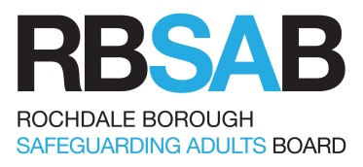
Safer Sleep for Babies
Louise Wileman
Specialist Health Visitor / Care of Next Infant (CONI) Co-ordinator
Rochdale Care Organisation
Northern Care Alliance NHS Foundation Trust

Slide 2
Aims and Objectives of the Session
Introduction to Sudden Infant Death Syndrome
Understanding of vulnerable babies and families
Update on current evidence-based safer sleep advice including the latest co-sleeping advice
Sleeping product advice

Slide 3
What is Sudden Infant Death?
Notes:
The sudden and unexpected death of a baby is usually referred to as ‘sudden unexpected death in infancy’ (SUDI) or ‘sudden unexpected death in childhood’ (SUDC), if the baby was over 12 months old
Some sudden and unexpected deaths are explained by the post-mortem examination e.g. an unforeseen infection or metabolic disorder
Deaths that remain unexplained (no cause is found) after the post-mortem are usually registered as ‘sudden infant death syndrome’ (SIDS) or SUDC in a child over 12 months. Sometimes other terms such as SUDI or ‘unascertained’ are used
‘Cot death’ was a term commonly used in the past to describe the sudden and unexplained death of an infant.

Slide 4
Rate of sudden infant deaths per 1,000 live births: 1989–2019 (England & Wales, 0 to 12 months)*
2019 rates show 0.27 SIDS per 1000 live births, seeing a continued reduction.
*Unascertained deaths included from 1997 onwards
Source ONS 2019: 2017 figures are provisional
Notes:
2019 SIDS deaths at new record low in England and Wales. Figures released by the Office for National Statistics (ONS)in August 2021 show that the number of deaths dropped significantly from 226 (a rate of 0.32 deaths per 1,000 live births) in 2016 to 170 (a rate of 0.27 deaths per 1,000) in 2019. This is an improvement on 2016’s figures, which showed that the SIDS rate rose against the trend for the first time in 3 years.
The ONS attribute the decrease to a reduction in maternal smoking and increased awareness of safer sleep advice, referencing the NHS, Welsh Government and The Lullaby Trust.
“For example, since 2015, The Lullaby Trust has held an annual awareness Safer Sleep Week Campaign promoting safer sleep advice, where a number of health authorities participated to raise public awareness. The Lullaby Trust has also trained health professionals working with new and expectant parents how to advise on safer sleep practices” (ONS report https://www.ons.gov.uk/peoplepopulationandcommunity/birthsdeathsandmarriages/deaths/bulletins/unexplaineddeathsininfancyenglandandwales/2017)

Slide 5
SIDS in Numbers - 2019
​
196
SIDS claims the lives of approximately 200 babies in the UK every year – that’s around 4 babies a week
20.000
lives saved
The rate of SIDS has reduced by 82% since the launch of the Back to Sleep message in 1991
Source: ONS 2019.
Notes:
170 unexplained infant deaths occurred in England and Wales in 2019
0.27 deaths per 1,000 live births a statistically significant decrease from 0.32 deaths per 1,000 live births in 2018 (213 deaths in total)
This number has remained relatively stable since the early 2000s and has not seen the same decline as SIDS in babies under 12 months

Slide 6
Latest ONS figures 2021 (2019)
SIDS 196 babies lives lost (230 in 2018) in UK, 4 babies per week
170 babies lives lost in England (0.27 per 1000 live births, 1 per 3767 live births
SIDS accounted for 59.4% of unexplained deaths in UK
SIDS rates higher in boys 55.3%
Mothers under age of 20 5 times more likely to experience unexplained infant death 0.96% deaths per 1000 live births
Notes:
1 per 3767, current unexplained infant death rate in UK for live births.
Bullet point 2 Reduction from 2018, 0.32 per 1000 live births/213 in total)
Bullet point 4 SIDS in boys 57.6% in 2018
NOTE strong possibility due to the coronavirus pandemic that there has been a delay in coroners proceedings

Slide 7
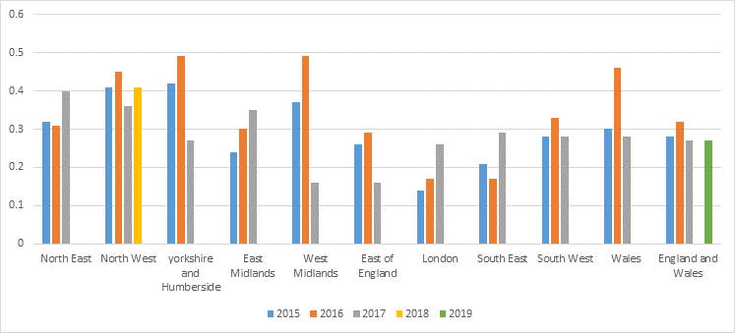
Rate of sudden infant deaths around the country -England and Wales, 2015–2019 (0–12 months)

Slide 8
Latest ONS figures, 2019

Slide 9
Safer Sleep Work In Rochdale
Multi Agency Safe Sleep Guidance
Multi Agency Safe Sleep Risk Assessment
Safe Sleep launch event – October 2020
Engagement with parents via Children’s Centre consultation
Room Thermometers- funded by Public Health for all expectant parents
Safe Sleep Champions – recruited to
Developing Coping with Crying Guidance to incorporate ICON messages

Slide 10
Which babies are most at risk?
Babies who are born prematurely before 37 weeks or at a low birth weight are also at higher risk of SIDS
86%
Around 88% of SIDS happen in the first six months of life
55%
Boys are more at risk of SIDS than girls – more than 55% of unexplained infant deaths in 2018 were boys.
6x
Babies born at low birth weight are five times more at risk of SIDS than babies born at a normal birth weight.
Source: ONS 2019
Notes:
Some risk factors are non-modifiable
In 2017 around 88% of deaths happened in first 6 months of life. SIDS occurs less frequently in the first month of life, peaks between 2 and 4 months of age and decreases thereafter
55.2% of all unexplained infant deaths were boys in 2017.
In 2017, the unexplained infant mortality rate for low birthweight babies (under 2,500 grams) was 1.04 deaths per 1,000 live births. This was five times higher than babies with normal birthweight (2,500 grams and over) at 0.20 deaths per 1,000 live birth.

Slide 11
Highest risk groups
Lifestyle and environmental factors
Which groups are at an increased risk?
Babies who die of SIDS are more likely to be born to:
Disadvantaged families
Young mums particularly those under 20
Unmarried or sole parents
Mums who smoke during pregnancy
By targeting interventions at those families most at risk we can make a difference and tackle health inequality

Slide 12
Why young parents?
5X
In 2019 the rate of SIDS was five times higher among mothers under 20 compared to all other age groups.
21%
Babis born to women under 20 are 21% higher risk of having a low birth weight.
Under 20
Mothers under 20 are a third less likely to start breast feeding and half as likely to be breast feeding at 6-8 weeks
3X
Mothers under 20 are three times more likely to smoke during pregnancy
56%
The infant mortality rate for babies born to women under 20 is 56% higher
3X
Teen mothers are three times more likely to experience postnatal depression
A framework for supporting teenage mothers and young fathers, Public Health England, May 2016
Notes:
The Lullaby Trust decided to focus on working with young parents because babies born to young parents are five times more likely to die as a result of SIDS.
The SIDS rate for babies born to mothers under 20 has declined by 11.3% since 2004. The rate SIDS decreased for mothers of all age groups since 2004 but the smallest decline was for mothers aged under 20 years

Slide 13
Why this baby?
Baby usually aged less than 6 months. SIDS peaks between 2-4 months
Critical development
period
Modifiable risk factors e.g.:
Unsafe sleeping positions
Unsafe sleeping environments
Temperature and overwrapping
Prematurity
Low birthweight
Smoking, drug and alcohol use during pregnancy
Genetic factors
SIDS
Vulnerable baby
Physiological or developmental vulnerability intrinsic to the baby
Exogenous stressors
External modifiable risk factors
Reducing and increasing the risks of SIDS
Source: Filiana and Kinney 1994
Notes:
We still do not know what causes SIDS – remember these are risks and not the causes. Many parents don’t follow all the advice and their babies don’t die – why?
For many babies it is likely that a combination of factors affect them at a vulnerable stage of their development
Triple Risk Model helps to explain how these modifiable and non-modifiable risk factors may act together
SIDS is comparatively rare but it can still happen
By following the evidence based safer sleep advice for the first 12 months it is possible to lower the chance of SIDS occurring
Advice should be followed consistently and for all sleep periods
There is no advice that guarantees the prevention of SIDS
The triple risk hypothesis
Data from population (epidemiological) studies indicate that there are numerous risk factors for SIDS that act together to increase or decrease the chance of death. SIDS is therefore thought to be due to multiple factors acting in a given situation. The ‘triple risk hypothesis’ has been suggested as a model of how risk factors might act to cause SIDS. This model suggests that SIDS occurs due to a combination of factors including:
1. The infant is vulnerable (e.g. they may have a physiological impairment of some kind)
2. The infant is at a critical period of development
3. There is an external factor in action (e.g. the infant is placed prone to sleep)
While this model may help to explain how risk factors might act together when SIDS occurs, we still need to know exactly what is happening in the body to cause SIDS even if these factors are present – i.e. the potential ‘mechanisms’ underlying the syndrome.
We still do not know what causes SIDS
For many babies it is likely that a combination of factors affect them at a vulnerable stage of their development
Triple Risk Model helps to explain how these modifiable and non-modifiable risk factors may act together
SIDS is comparatively rare but it can still happen
By following the evidence based safer sleep advice for the first 12 months it is possible to lower the chance of SIDS occurring
Advice should be followed consistently and for all sleep periods
There is no advice that guarantees the prevention of SIDS
Launch test

Slide 14
Talking to families
Safer sleep must be discussed with all families
Discussions around some areas of safer sleep advice can be challenging
Acknowledge that young babies wake and feed frequently: this is normal and self-limiting, there is no need to find a ‘solution’
Signpost and share information with families and carers
Notes:
Before going through the advice it is useful to consider how in your professional role / agency you will deliver the safer sleep advice to families
Discussions about safer sleep should happen antenatally and postnatally, and can be challenging – acknowledge that young babies wake and feed frequently and this is normal and self limiting, there is no need to find a solution
Key role of midwives and health visitors but anyone working with families with young babies
Advice needs to be discussed with all families
It isn’t just mums who look after babies, dads need the advice too. Is the baby being looked after by grandparents? Do they have up to date information
Does the baby have somewhere safe to sleep when not at home? Holidays?
Does the baby always sleep at home? Who else looks after the baby? How can I include all carers?
Professional leaflet gives tips about having conversations about safer sleep
When do you give the advice?
Who gives the advice?
Universal advice – all families need the information to make an informed choice
Safer sleep advice may be challenging and there are no magic answers
Babies wake and feed frequently - no need to find a solution

Slide 15
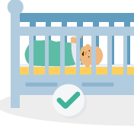
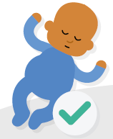
Safer Sleep Key Messages
Put babies on their BACK for every sleep
In a CLEAR, FLAT SLEEP SPACE
Keep them SMOKE FREE day and night
Notes:
Safer sleep information has saved many babies’ lives, however over 196 babies still die every year. We have accurate information about how and where babies die and research that tells us how to prevent them dying. Your role is crucial by talking to families and supporting them with understanding how to avoid the specific risks for their baby, we can help reduce the number of babies dying
Key messages The number of babies who die of SIDS could be reduced dramatically if families follow 3 key pieces of advice.

Slide 16
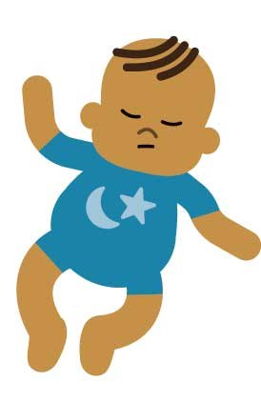
Sleep position
Front sleeping and side sleeping are known risk factors
Front sleeping is particularly dangerous for:
Babies who are normally slept on their backs
Babies born pre-term or at a low birth-weight
Why do parents still sleep babies on their tummies?
Potential mechanism?
Infants sleeping on their fronts have significantly decreased arousability compared with those sleeping on their backs
Notes:
“The risk of SIDS is over 6 times higher in babies who are routinely placed on their front to sleep compared to babies who are placed on their backs” – this figure refers to the usual sleeping pattern, day and night.
Talk through slide and then launch test why do parents still sleep babies on their tummies?
Neonatal ward practice
Reflux/vomiting choking concerns
Flat head (plagiocephaly)
‘My mum slept me on my tummy’
Parental tiredness
Neonatal tummy sleeping - importance of safer sleep discussion at hospital discharge
Reflux/vomiting - The Evidence Base says: ‘It is often thought that sleeping healthy babies on the back puts an infant at greater risk of death through aspiration of vomit and choking but there is no evidence to substantiate this. The widespread adoption of the supine position in the UK has been accompanied by a fall in post perinatal mortality rates and no increase in aspiration death rates.’
Babies with reflux should still sleep flat on their backs. (LT Safer Sleep Advice for Premature Babies Leaflet 2018)
If a baby has reflux, or any other on-going health condition, then a doctor should be consulted about the best care for them.
The Evidence Base says: ‘It is often thought that sleeping healthy babies on the back puts an infant at greater risk of death through aspiration of vomit and choking but there is no evidence to substantiate this.51 The widespread adoption of the supine position in the UK has been accompanied by a fall in post perinatal mortality rates and no increase in aspiration death rates.52’
Definition of supine:
Pertaining to a posture in which the anterior portion of the body faces upward, the torso is aligned parallel to the reference surface, and hips and knees extended Medtalk Lying on the back.
McGraw-Hill Concise Dictionary of Modern Medicine. © 2002 by The McGraw-Hill Companies, Inc.
From Kate Holmes: September 2019
'The advice we give on the helpline is we don’t recommend tilting a cot, this has to be the parent's own choice as the ideal position is flat.
However, if parents do decide to tilt the cot we would add to make this a small tilt to see if this helps at all. And whatever is used must make sure the cot remains stable. If the manufacturer's instructions say not to do this then we wouldn't recommend it either.
We would always advise that from the point of view of SIDS prevention a baby should be slept on their back on a firm, flat, waterproof mattress, so we would not advise putting anything under the mattress that could cause it to bend.
We also add….
Our safer sleep advice is for all babies, we don’t look at the individual needs of a baby hence we refer families back to their GP for more advice and medical support, as we are not medically trained. If a GP recommends something we wouldn’t over rule it.'

Slide 17
The safest place for a baby to sleep
The safest place for your baby to sleep is a separate cot or Moses basket in the same room as you for the first six months, even during the day.
Notes:
This standard advice we would give and there has been lots and lots of research as to why.
A large study across Europe showed that the chance of SIDS was halved when a baby shared a room with their parent or carer, compared to sleeping in a nursery alone
Parents should be advised that the safest place for a baby to sleep for the first six months is in a separate cot or crib in the same room as them for all sleeps
This can include a Moses basket, travel cot or carrycot for day time sleeps
No study has found bed sharing to be associated with a reduced risk of SIDs
Advice for families with little or no room for a cot
I appreciate that it isn’t always possible and know that following the advice may become more difficult for families where there is no room or money for cot or where they are in temporary accommodation.
The factsheets on bed sharing and mattresses, bedding and cots may also help
factsheet 3 states – remember – sleeping in the same room as your baby has also been known to lower the change of SIDS. The chance of SIDS is lower when babies sleep in the same room as their parents, but do not share the bed.
Our advice – As research is still emerging, our core safety message is always: Place your baby to sleep in a separate cot or moses basket in the same room as you for the first six months. Babies rely on the comfort of being close to their parents or carers, and need this during the night as well as during the day. Sharing a room with your baby enables you to respond early to cues such as murmuring or restlessness in your baby, without them starting to cry or becoming distressed.
Some other options they could consider,
Travel cot - is there space for this in the room? It would need to have a firm, flat mattress.
A draw (pulled out of a chest of drawers) will need a fitted firm mattress inside it and to make sure baby is not too big for the draw (in Finland, all families when they have their first baby are given a cardboard box with a mattress for the baby to sleep in this was done to help reduced infant mortality, I appreciate that this may not be something that this family will consider)
If the babies room is close by can the baby safely sleep in there in a cot/moses basket and the foster carers make sure doors to both bedrooms are open and with NO layered bedding
A cot that pulls up close to the bed this is an example only (we cannot comment or endorse on individual products), I appreciate the cost is an implication. You would also need to consider the safety aspects of any gaps between the cot and adult bed etc
Re-arranging furniture in the room to fit a cot.

Slide 18
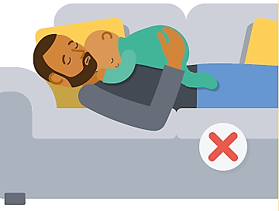
The most dangerous risk to take
Co-sleeping on a sofa or armchair is significantly more unsafe than bed-sharing
Never sleep on a sofa or armchair with a baby - this can increase the risk of SIDS by 50 times¹
In addition to SIDS there is a risk of entrapment or overlaying
Discuss planning solutions e.g. Moses basket, partner takes baby
¹Blair, Sidebotham, Evason-Coombe et al. 2009
Notes:
Slide is animated before bringing in rest of slide – ask the question, what is the most dangerous risk to take? Ask participants to ‘chat’ their answers
This is also a poll if preferred
Sofa sharing infants are also more likely to be placed in a non-supine position, to have been exposed to tobacco smoke prenatally, and for the sofa to be an unusual sleep location (e.g. parents falling asleep on the sofa accidentally), 112 although the sofa is still an extremely risky environment even if it is the customary place for the infant to sleep. Mothers and fathers are just as likely to sofa share.

Slide 19
Bed sharing – universal advice
Discuss bed-sharing with all families however they choose to feed their baby
Be open and non-judgemental
Beware of assumptions
Explore – why is the family bed-sharing? Do they have an alternative safe sleep space?
Plan – every family needs a plan to avoid unsafe, accidental bed sharing
If the family are in a high risk group we need to tell them why
High risk bedsharing
Notes:
Our guidance is for all families, however they feed their babies and does not include specific recommendations for formula or breastfed babies. We would like to ensure that all families know all the information around bedsharing. The highest risk situations highlighted in the information we have produced are not linked to one method of feeding only. We want parents to be aware of these, no matter how they choose to feed their baby as most parents will co-sleep at some point.
According to a recent Bounty study over a third of parents (36%) regularly share a bed with their baby * *Safer Sleep Week 2019
25% of parents sometimes share the bed
Why Bedshare?
historical / cultural
peer pressure
feeding
space / housing
Conflicting advice
After last bullet point launch test high risk bedsharing?

Slide 20
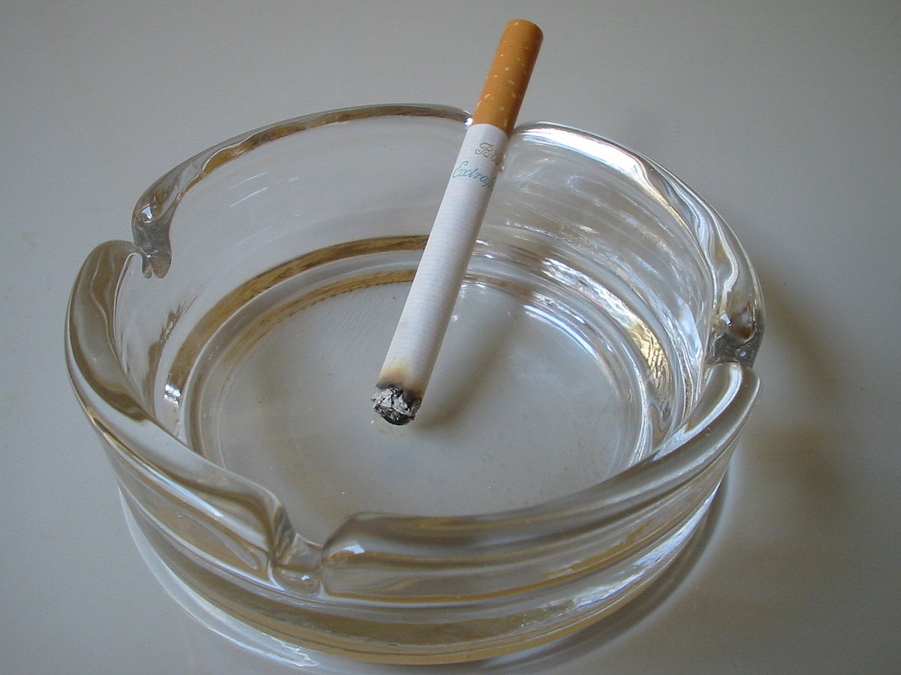
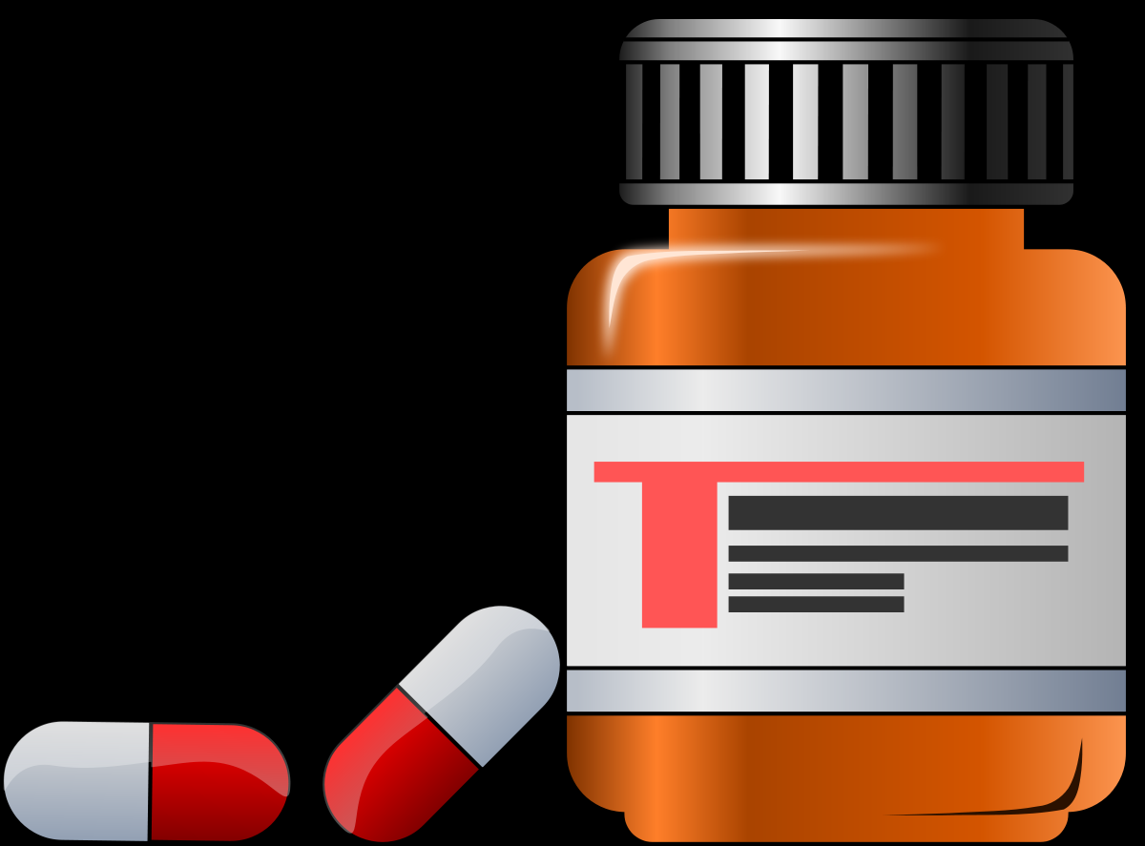
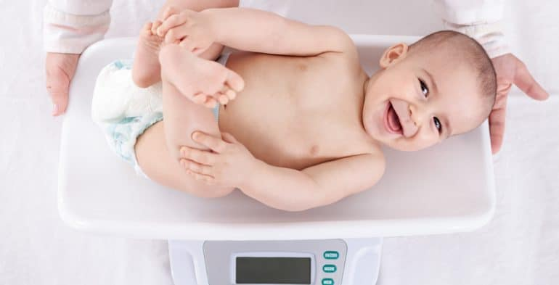
When not to bed share
You should never sleep together with your baby if any of the following points apply to you or your partner:
Either you or your partner smokes (even if you do not smoke in the bedroom)
Either you or your partner has drunk alcohol or taken drugs (including medications that may make you drowsy)
Your baby was born premature (37 weeks or less)
Your baby was born at a low weight (2.5kg or 5½ lbs or less)
Notes:
Use this slide to recap answers from the test
In these scenarios, it is always best to put baby in their own safe sleep space such as a cot or a Moses basket. Keeping the cot or Moses basket next to the bed or sofa might make it easier to do this. Anytime parents are under the influence of drugs or alcohol a sober adult should be in charge of the baby

Slide 21
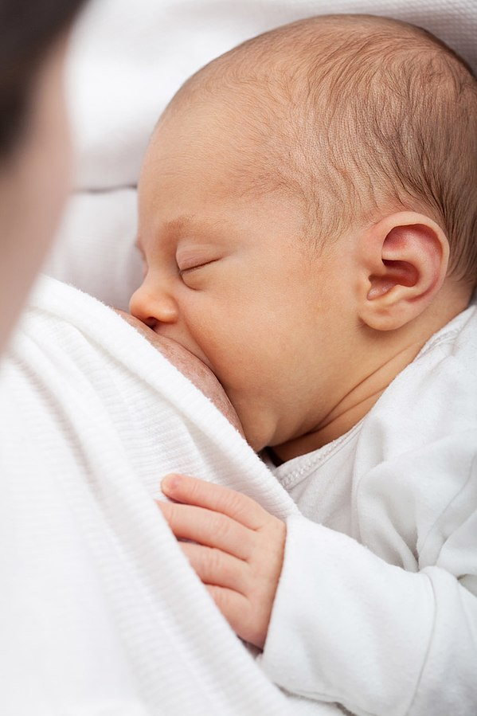
Breastfeeding reduces the risk of SIDS
Any breastfeeding, even for a
few days, is better than none,
but the Department of Health
recommends that babies are
exclusively breastfed for six
months
Notes:
Historically research has identified a link between breastfeeding and reduced SIDS risk.
Breastfeeding, either exclusively or in combination with formula milk, is associated with a reduced rate of SIDS in women where there are no contraindications that advise not to breastfeed.
The minimum duration of breastfeeding needed to confer protection against SIDS is at least two months, with greater protection seen for longer durations of breastfeeding.
Any breastfeeding, even a few days, is better than none, but most authorities including the Department of Health now recommend that babies are fed only breast milk (exclusively breastfed) for at least six months
As long ago as 1965 it was shown that babies under 3 months who died of SIDS were less likely to be breastfed than infants who did not die. Since then, numerous studies have linked breastfeeding with a lower risk of SIDS.
A Recent study has shown that babies who were at least partly breastfed were one-third less likely to die as a cot death than babies who were never breastfed*
Formula feeding does not increase the chance of SIDS – breastfeeding lowers the chance
The most recent meta-analysis, published in 2017, examined the relationship between duration of breastfeeding and decreased SIDS risk. The analysis did not find evidence of a greater protective effect from exclusive breastfeeding compared to any breastfeeding. 6 Thompson JMD, Tanabe K, Moon RY, Mitchell EA, McGarvey C, Tappin D. Duration of breastfeeding and risk of SIDS: an individual participant data metaanalysis. Pediatrics. 2017;140(5):e20171324.

Slide 22
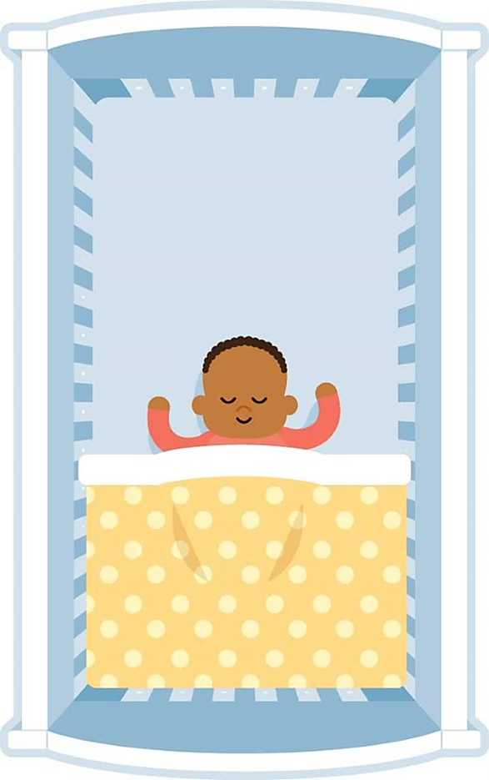
Bedding and head covering
Use of bedding which covers the head is an independent risk factor
Sheets and blankets should be firmly tucked in
Feet to foot
Consider using a baby sleep bag
Notes:
The head is an important source of heat loss for a normal baby
A high proportion of infants who die as a result of SIDS are found with their head covered with bedding
The use of bedding, which covers the head is an independent risk factor

Slide 23
A clear cot is a safer cot:
No pillows or duvets
No cot bumpers
No soft toys
No loose bedding
No products that keep the baby in one position, such as wedges or straps
Notes:
Taken from product guide;
No pillows, quilts or duvets, bumpers
Pillow use alone has been shown to increase the risk of SIDS by 2.5 times compared with non-pillow use
No pods, nests or sleep positioners
No soft toys
No loose bedding
No products to keep a baby in one sleeping position such as wedges or straps
Reason: soft or raised surfaces,pillows or quilts can increase the chances of SIDS by making it difficult for babies to breathe or cool down.

Slide 24
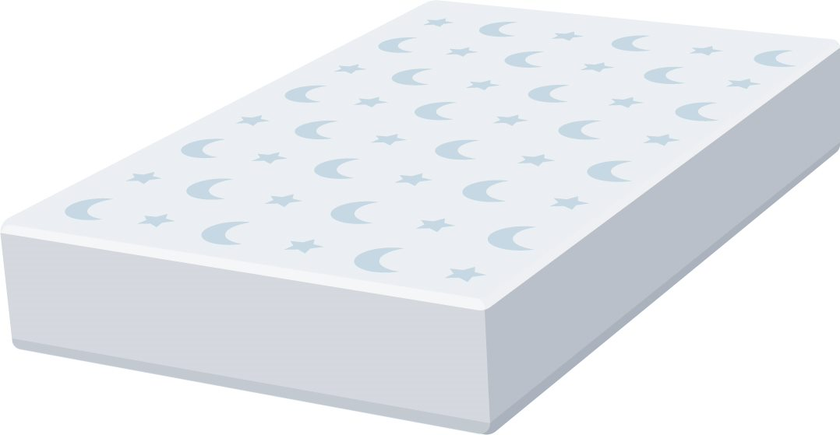
Mattresses
Flat, firm and fit the cot well
Undamaged waterproof cover, thoroughly cleaned and dried before use
Generally we advise it is safest to have a new mattress for each baby, though we know this isn’t always possible
Second-hand mattresses from another home might increase the risk slightly
In addition, the use of soft sleep surfaces has been found to be associated with a higher risk of SIDS
The surface of the mattress should be firm enough that when your baby is placed on it, their head does not sink in more than a few millimetres.
No hammocks – these aren’t firm or flat!
Notes:
Mattresses should be:
Flat – entirely flat with no raised or cushioned areas
Firm – baby’s head should not sink in by more than a few millimetres
Fit the cot well –well fitted with no gaps between cot and mattress
Waterproof – a waterproof cover helps to stop bacteria building up inside the mattress so there is less risk of infection, which may increase the risk of SIDS, rather than being breathable, it is more important that a mattress is waterproof or has a waterproof cover
Second hand mattress from another home might increase the risk slightly – There is a slight increased risk of SIDS when using a second-hand mattress when the mattress has come from outside the home (and not when the mattress has been used by your own child previously). The difference being, you don’t know the history of the mattress from outside the home.
If parents reuse a mattress we do advise they check the mattress is still firm, flat, and in good condition (there are no rips, tears or sagging and the waterproof cover has provided full protection; no fluid has leaked into the mattress). A waterproof cover for a mattress is important for keeping it clean and dry and prevents the harbouring of any bacteria in the mattress.
Soft bedding and mattresses have been shown to be important risk factors for SIDS, they make it harder for babies to loose body heat, which can cause them to become too hot * NB: implications for bedsharing
A soft mattress is especially dangerous for a baby slept on their front
If you choose a second mattress make sure it has been storied somewhere clean, dry and smoke-free. There is some evidence to suggest that bringing in a mattress from another home might increase the risk of sudden infant death very slightly
From product guide: It is important that the mattress is firm, entirely flat, and waterproof, with no soft or cushioned areas, particularly around baby’s head. Soft mattresses are known to increase the risk of SIDS. They make it harder for babies to lose body heat, which can cause them to become too hot.

Slide 25
Other sleep surfaces
We know there are lots on the market, so questions to ask:
Is it firm?
Is it flat?
Does the mattress have a waterproof cover?
Can bedding be firmly tucked in?
British safety standards – does it conform?
Keep it simple, keep it safe!
Notes:
There are no standards that look specifically at whether a product decreases or increases the risk of SIDS; most cover other issues such as the construction of the item, chemicals or fire safety
To reduce the risk of SIDS parents should be advised to pick products that allow them to follow safer sleep advice such as sleeping bags, which stop babies from wriggling under covers

Slide 26
Overheating Temperature Overwrapping
Notes:
From evidence base: While it is important to ensure that a baby does not get too cold, it is also important to avoid care practices that may result in the baby getting too hot. As such, babies should be checked to ensure that they are a suitable temperature and clothes and bedding are appropriate for the room temperature. Babies should not wear hats indoors or when asleep.
Babies should be checked they are a suitable temperature - check babies chest and/or back of their neck to make sure their skin doesn't feel clammy to the touch, (their hands and feet will always feel cold.) If the skin feels clammy it means they are too hot so remove a layer of bedding or what they are wearing.
Babies should not wear hats indoors. Wearing hats during day or night sleep can increase the risk of SIDS by more than three times (OR 3.12, 95% CI 1.39- 7.01)
Whilst it is important to ensure that a baby doesn’t get too cold, it is also important to avoid care practices that may result in a baby getting too hot
Babies should be checked they are a suitable temperature – check babies chest and/or back of their neck to make sure their skin doesn't feel clammy to the touch
Babies who are unwell need fewer, not more bedclothes
Tonkin SL. Epidemiology of cot deaths in Auckland. N Z Med J. 1986;99(801):324-6

Slide 27
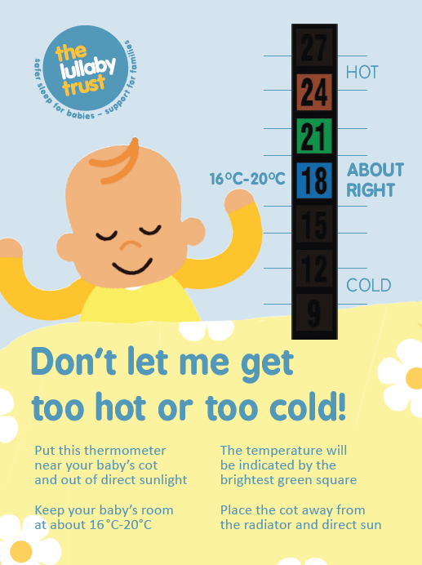
What is the ideal room temperature?
16–20°C
Adjust bedding and/or clothing so suitable for room temperature
Top Tips for hot rooms
Close the blinds/curtains and, if safe to do so, keep a window open during the day to keep the room for getting too hot.
Putting a fan in the bedroom can help to circulate the air, but make sure it is out of reach and not pointed directly at the baby.
Reduce layers: just a nappy with no bedding is fine in hot weather.
Monitor the temperature with a room thermometer.
Notes:
Recommend that the temperature is between 16 - 20 C depending on what clothing and bedding the baby has
We do not recommend duvets for babies under one year
We recommend light blankets
We do not give specific guidelines on the number of blankets as there are so many different types of blankets

Slide 28
Safer sleep in car seats
To reduce the risk of SIDS on long journeys:
Stop for breaks so the baby isn’t in the car seat for long periods
Remove hats and outdoor clothes when you get in the car
Ideally keep them in sight of an adult
Notes:
Car seats are essential for safety when travelling, but babies should not sleep in a car seat for long periods.
Car seats should not be used as an alternative for a highchair or cot.
Maximum time advised in the seat is 2 hours if travelling.
On longer journeys give baby regular breaks and ensure baby can be seen by an adult.
It’s okay for a baby to fall asleep in a car seat but take out as soon as can and place baby on firm, flat surface.
Be aware of baby's temperature when in car seat.
Maximum time is 2 hours – No evidence base regarding this so we follow Safety , infant care professionals and car manufacturers advise 2 hours. Fleming in his research mentioned 30 mins and some interpretation of research has used this figure as how long baby should be in car seat.
Regular breaks – Discuss use of mirror or adult in back when travelling so they can be observed by an adult.
Temperature – Discuss clothing , adjusting when travelling indoors, shopping etc...

Slide 29
Safer Sleep Key Messages
Put babies on their BACK for every sleep
In a CLEAR, FLAT SLEEP SPACE
Keep them SMOKE FREE day and night
Spot the risks
Notes:
Safer sleep information has saved many babies’ lives, however over 196 babies still die every year. We have accurate information about how and where babies die and research that tells us how to prevent them dying. Your role is crucial by talking to families and supporting them with understanding how to avoid the specific risks for their baby, we can help reduce the number of babies dying
Key messages The number of babies who die of SIDS could be reduced dramatically if families follow 3 key pieces of advice.

Slide 30
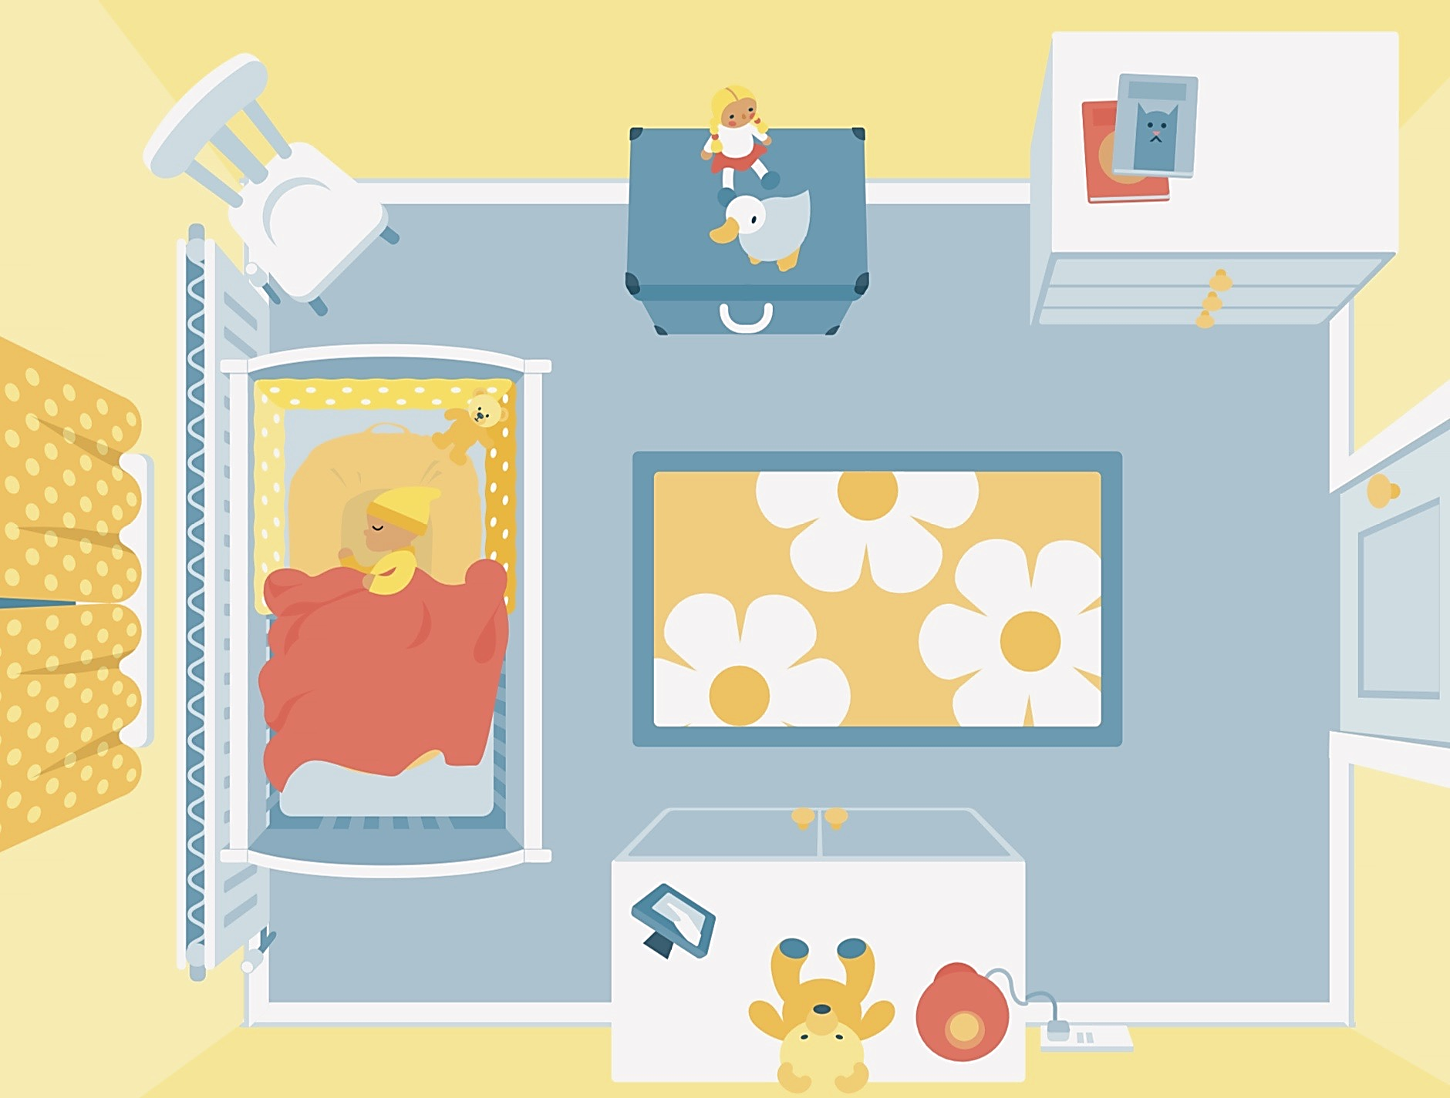
Spot the eight risks
Notes:
30
**This resource not to be used in isolation without our guidelines as the point on dummy use can be confusing for parents if just given in isolation (without guidance on breastfeeding/importance of consistency of dummy use).
Ask the participants to chat in their answers

Slide 31
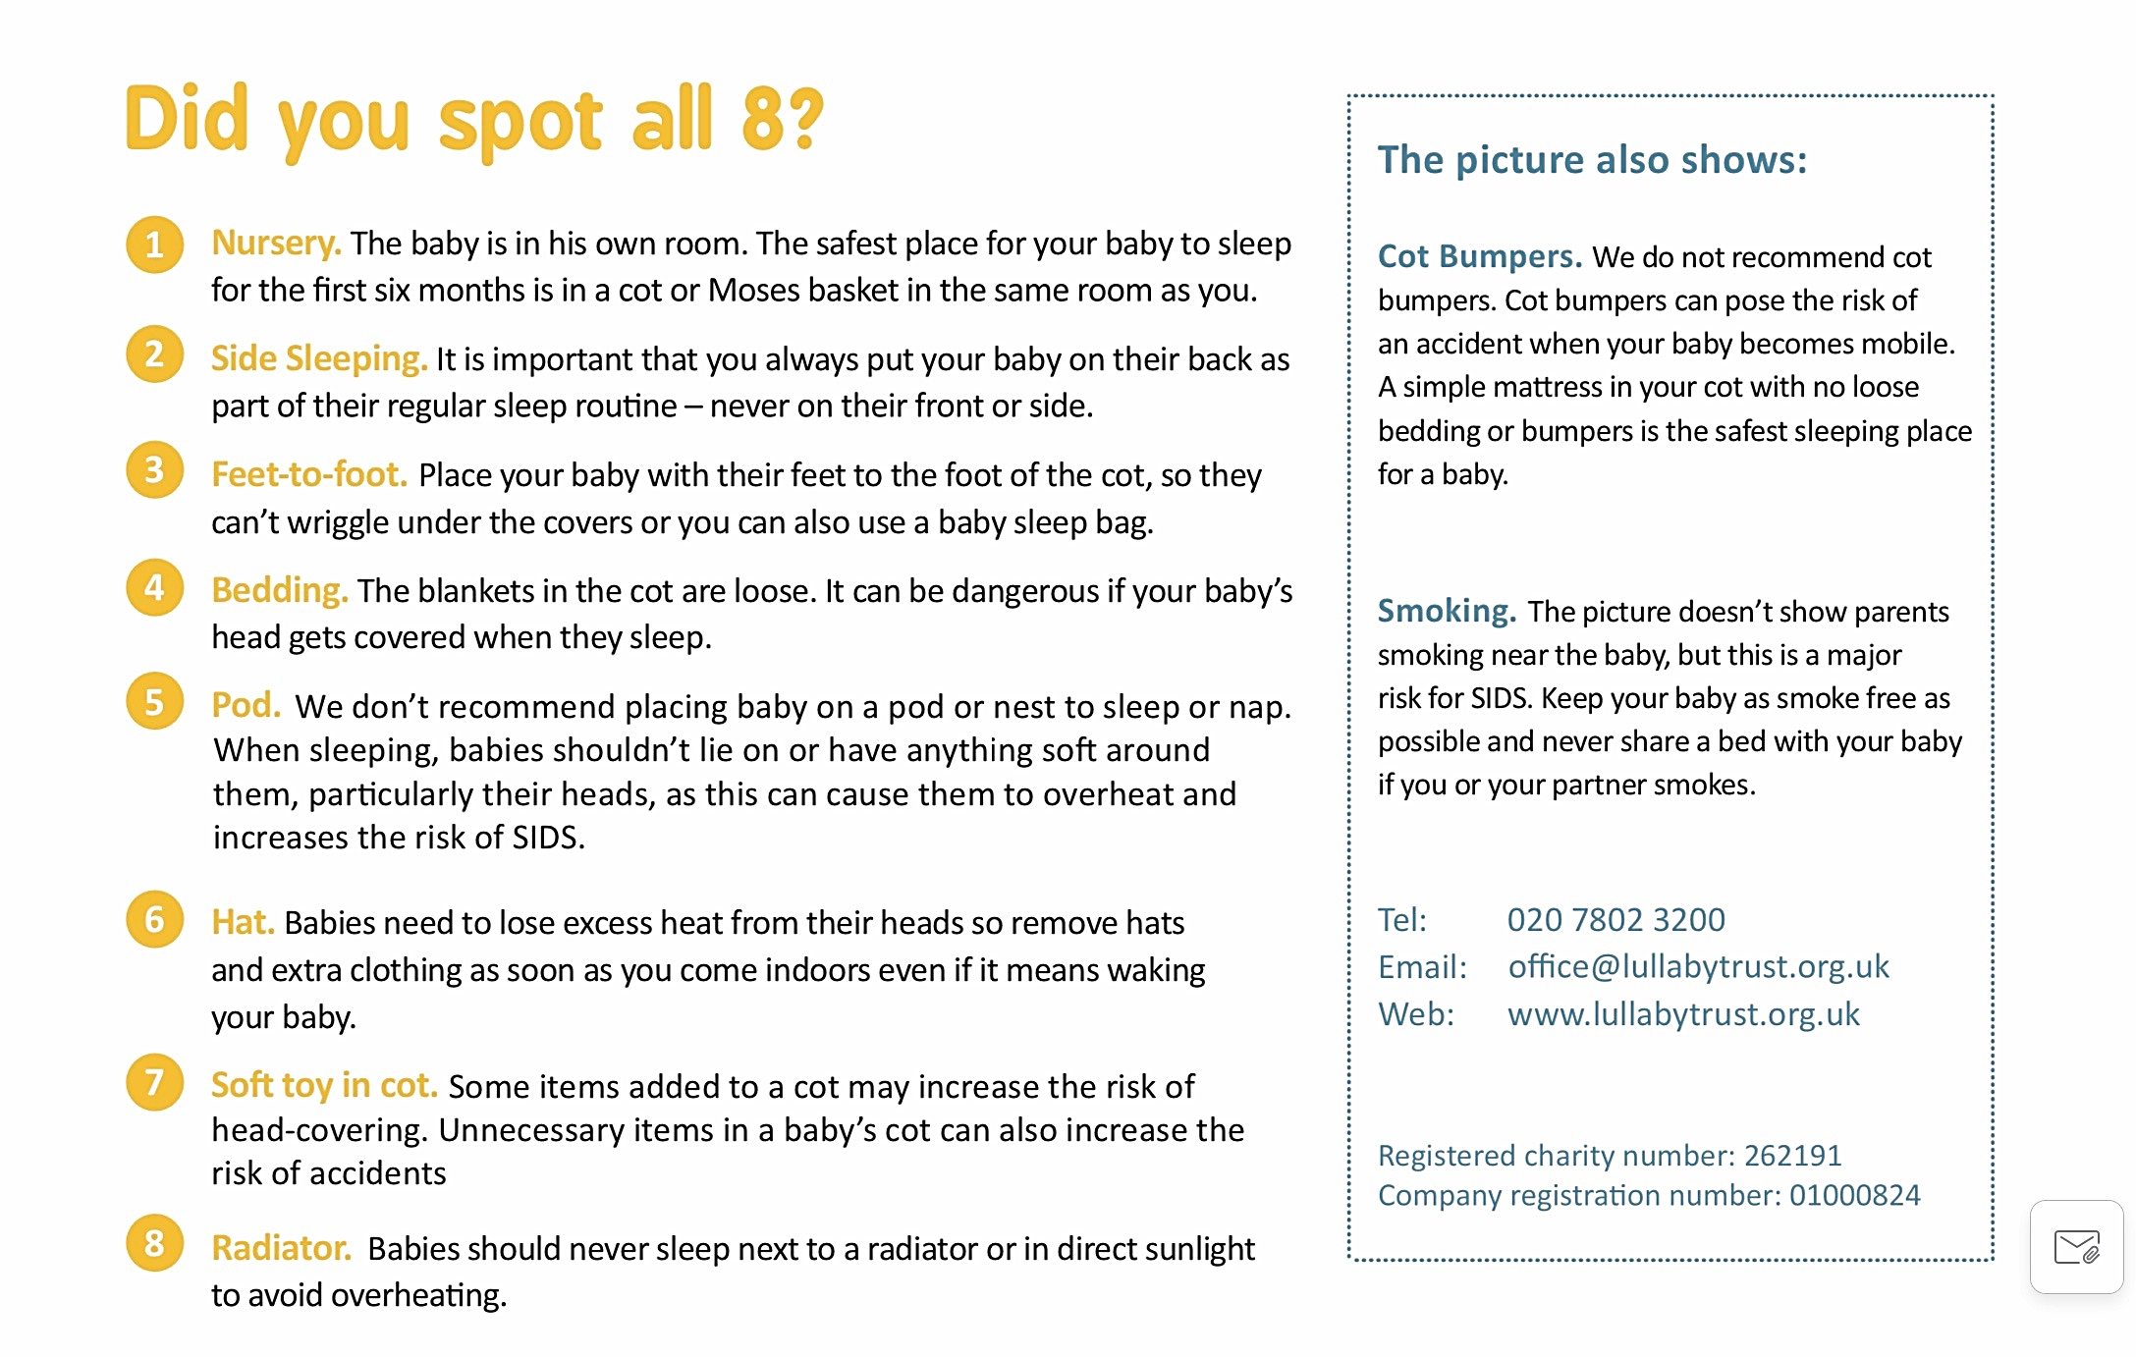

Slide 32
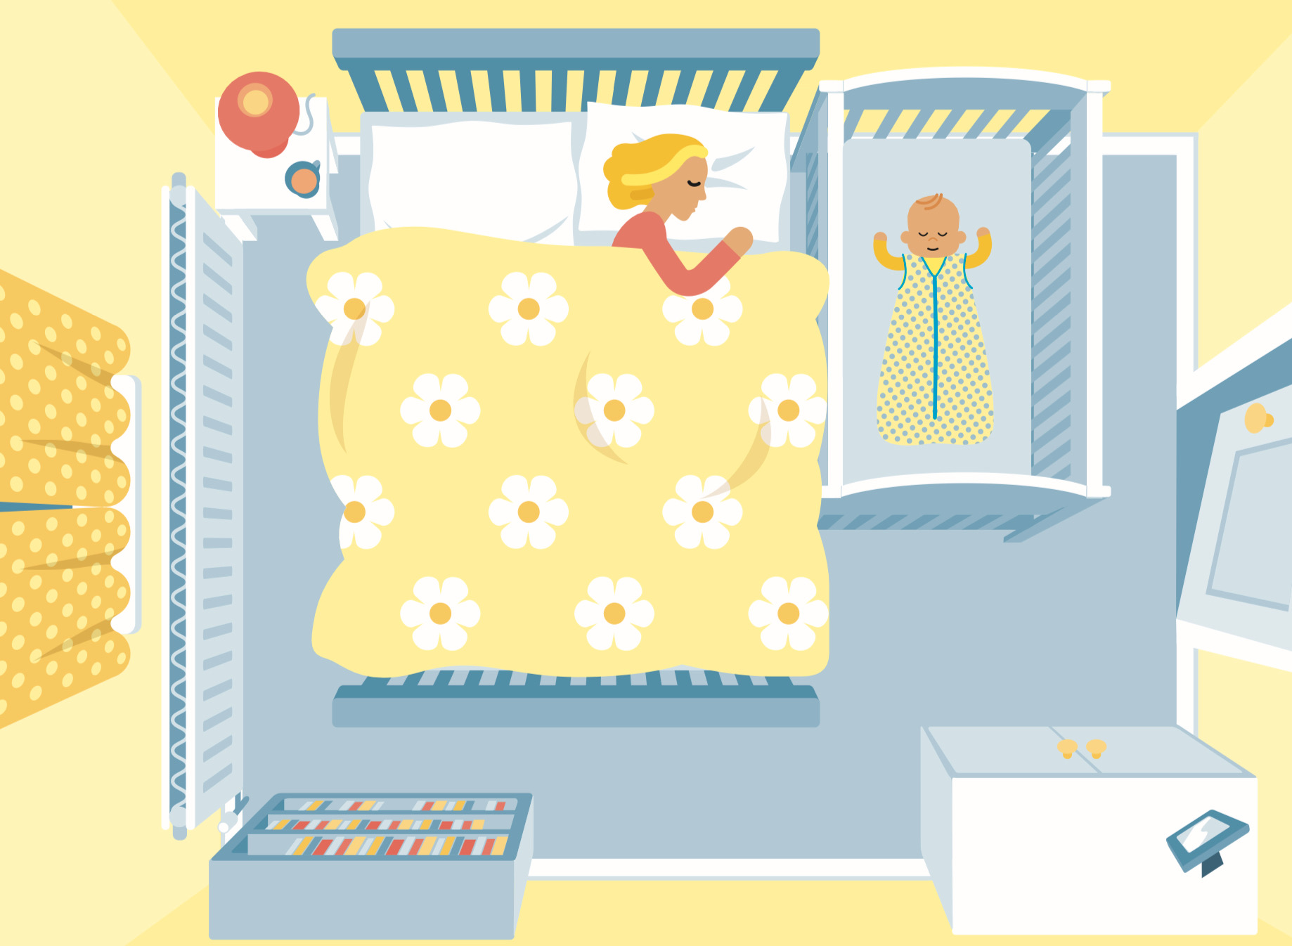
Notes:
32

Slide 33
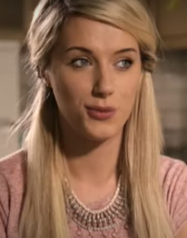
Loren’s Story
https://youtu.be/ImUfFIlc3rI

