Slide 1

Road map
How to make Trauma-Informed practice a reality

Slide 2

About the Roadmap
The roadmap sets out the strategic
approach, workstreams, and actions we
will take as a system to scale and
spread trauma-informed practice,
starting from the existing bright spots.
The roadmap sets out:
●
●
●
Design principles - these principles have guided the
design of the strategy
A scaling strategy based around a core team and sector-
specific sub-groups
The 4 workstreams for taking this work forward, and the
respective roles for the core team and the sector-sub
groups in each
●
An action plan for the next 12 months to maintain
momentum and progress
The purpose of the roadmap is to:
●
●
●
Explain our strategic approach to key stakeholders
Galvanise resources and activity across the system
Provide a clear way forward for Rochdale in the short-
term for making progress towards a trauma-informed
system

Slide 3
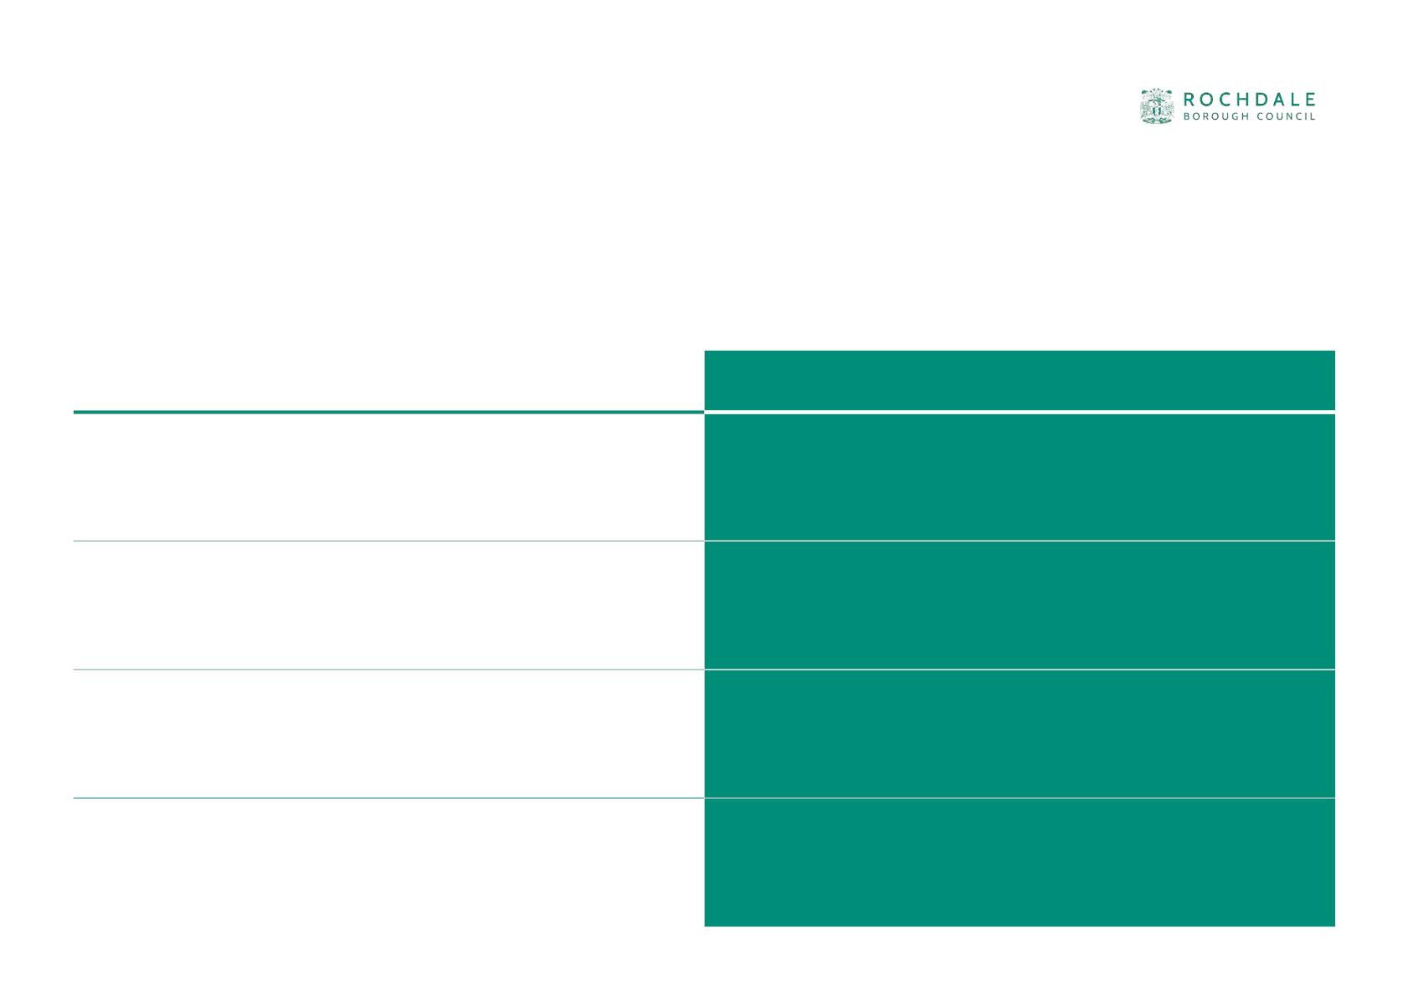
Becoming a trauma-informed borough
Through exploring existing good practice in the system, and understanding the
barriers to becoming a trauma-informed borough, the Design Group established
some design principles to inform the roadmap.
LEARNING FROM ROCHDALE
DESIGN PRINCIPLES
Everyone can apply trauma-informed principles in their work,
from leaders to casual staff, from universal to specialist services
and beyond.
Communicate a consistent vision with tailored approach to
meet the different needs of these job roles and sectors
Becoming trauma informed is a personal journey for
Create opportunities for people to have “AHA” moments
individuals. A training day alone is not enough
where they see the impact of trauma and the impact of TiP
Everyone is busy doing the day job, and it is easy for
immediate priorities to distract people from learning and
reflecting
Make it easy for people to learn about and apply trauma-
informed principles. This is not about doing new things, but doing
the same things differently
Organisational culture and systems can be barriers to
Support leaders to understand trauma-informed principles
individuals applying trauma-informed principles to their work
and to change the ethos of the organisation
3

Slide 4

Our approach
We want a consistent definition
and language around trauma-
informed practice, and to adapt
our practice to the context and
expertise in different parts of
the system.
Children’s and
Families’
Health
VCS
We will do this through:
●
A central core team to develop
shared training and resources and
support learning
Shared
Practice and
Resources
●
Sector-specific subgroups to tailor
resources, champion good practice
and identify barriers to becoming
more trauma-informed
Schools
Adult Services
Police and
Justice
4

Slide 5
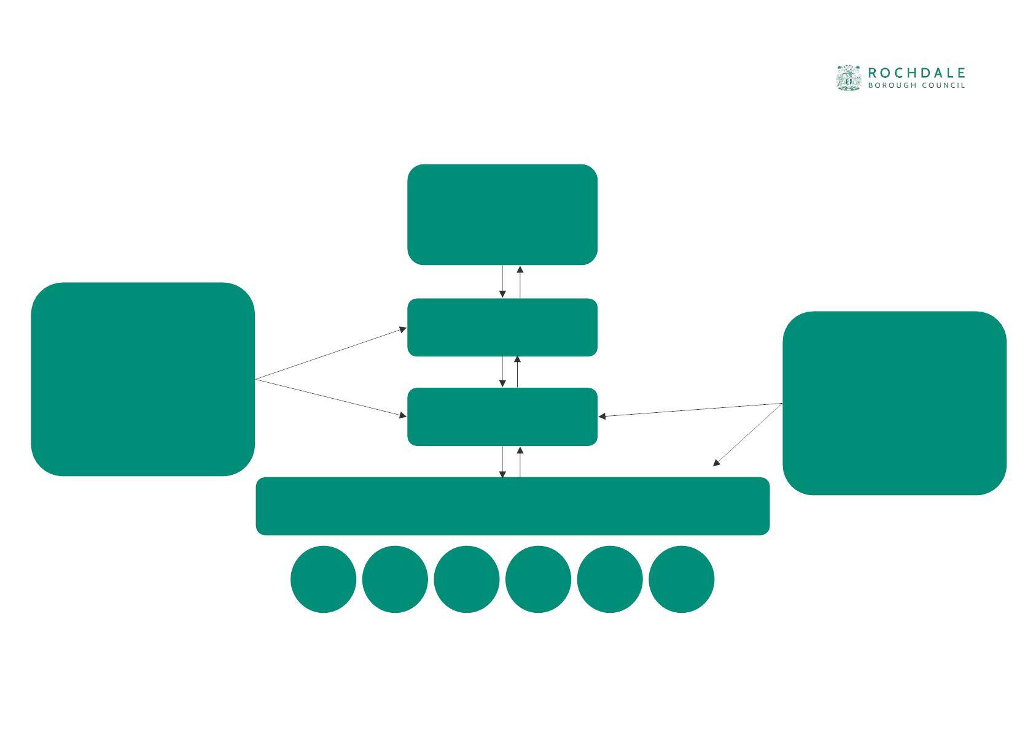
Possible governance and support structure
Children and
Young People’s
Partnership
Children’s services
transformation team
Steering Group
Design group
Safeguarding
Partnership
Provides governance
support to steering
group and design group
Provides operational
support for the 4
workstreams
Sector-sub groups led by Sector champions

Slide 6

System level workstreams
Core team
COMMS
TRAINING
TOOLS AND RESOURCES
LEARNING AND IMPACT
Tell the story of TiP and why it
matters
Map the different training
offers on TiP In Rochdale / GM
Recruit and support champions
Establish service-level survey to
report on progress towards TiP
Own and maintain tools to
support self-assessment in TiP
and deep listening with C&F in
each service
Communicate senior buy-in
and champions
Undertake training needs
assessment across the system
Establish partnership survey on
use of TiP
Encourage participation in sub-
groups, surveys and use of
tools
Develop competency
framework for TiP
Resource the analysis of
findings from org and
workforce surveys
Collate best practice from
across sectors
Define and resource:an basic
training offer for everyone and
a leadership training offer
Communicate journey and
impact
Collate and share tools from
across sectors
Share learning and impact with
DG and SG
6

Slide 7

System level workstreams
Champions and sub groups
COMMS
TRAINING
TOOLS AND RESOURCES
LEARNING AND IMPACT
Identify one or more TiP
champions
Identify existing training offers
in the sector
Adapt self-assessment and
deep listening tools to be
sector-specific
Promote the completion of
system-level surveys and share
findings
Adapt the TiP story using
relevant personas to
communicate
Develop a sector-specific
competency framework.
Provide opportunities to share
self-assessment findings within
the sector
Consider tracking or measuring
impact on sector-specific
metrics
Map training needs in the
sector - who and how
Identify meetings that can act
as sector sub-group.
Put forward proposals for
training and identify possible
resources
Identify and share best
practice within the sector
Share sector learning with the
design and steering group
Identify, events and
conferences to promote TiP
tools and resources and good
practice
Share system challenge and
asks with the design and
Steering group
7

Slide 8

Role of the TiP champion
Within each sub-group:
● Act as champion/leader for trauma-informed practice within their sub-group, including
● Promoting trauma-informed ways of working across our identified TIP features (i.e. recording; relationships;
safe environments etc)
● Highlighting best practice in the sector and sharing widely with others
● Identify opportunities for collaboration and shared learning with other sub-groups so good practice can be
scaled
At a system level:
● Meetings with TIP champions (Design Group) to support the delivery of the TIP roadmap (incl. Opportunities
for joint training)
● Connect with TIP champions to find solutions to common challenges/barriers, working together to leverage
senior support
● Connect with TIP champions to share opportunity and continue to create learning on best practice

Slide 9

Scaling and spreading Trauma-informed practice
Leaders
Core team
Champions + sub groups
Talk regularly about the
importance of trauma-
informed practice
Use existing
communications channels
to share the
Find more champions in
different teams and
services
Support champions to
have the time and
authority to promote
trauma-informed practice
communications package
Look for existing spaces
and groups to talk about
trauma informed practice
Embed trauma-informed
principles in all training
and workforce
Use trauma-informed
principles in policies,
strategies and decisions
about resources
development
Set up networks and
communities of practice to
talk about trauma
Use trauma-informed
principles in wider
transformation projects
and commissioning
strategies
Look for meaningful
opportunities to involve
people with lived
experience
Listen to the lived
experience of children,
families and communities
Celebrate great trauma-
Everyone
informed work through
awards and events
● Bring opportunities and resources to the Steering Group
● Share learning and listen to the learning of other sectors

Slide 10
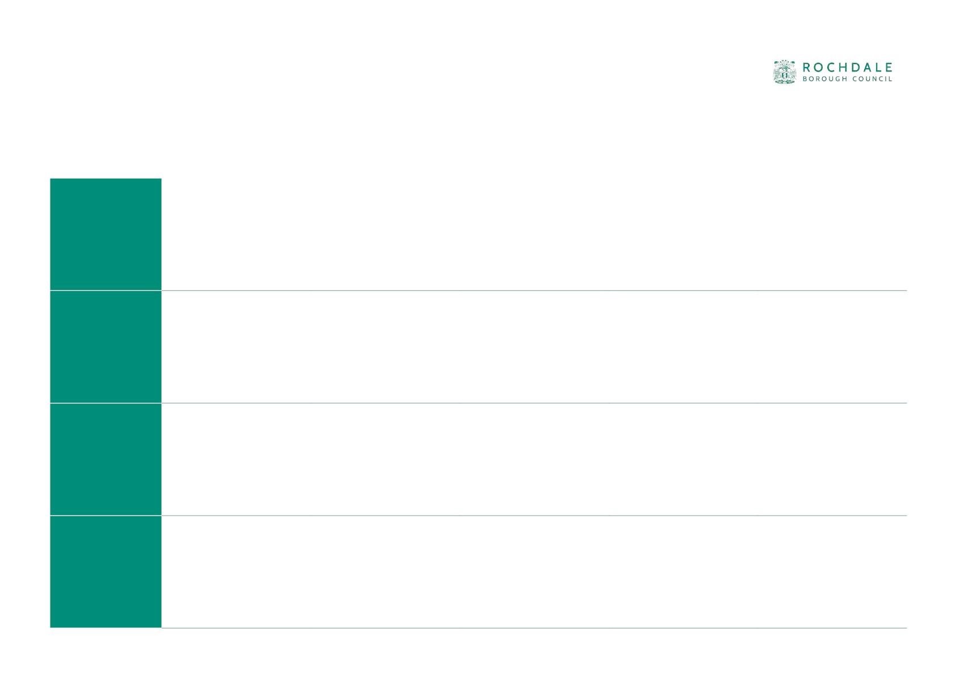
Action plan to Spring ‘23
May ‘23
Summer ‘23
Autumn ‘23
Winter ‘23
Spring ‘24
COMMS
Personas and tools
shared across the
borough
Promote training from
people with lived
experience
Borough-wide TiP
conference to share
learning so far
Comms package
designed and agreed
Commitment to
TiP publicised
Alexis
Beaumont
TRAINING
Training champions
identified
Mapping of existing
trauma training
Develop workforce
trauma competency
framework
Design a delivery model
for a partnership
training offer
Agree resources for
partnership training
offer
Lucy Chartres
TOOLS AND
RESOURCES
Sector sub groups
adapt tools for their
sector
Refresh of tools and
resources based on
feedback
Tools developed and
agreed
Sector champions promote tools in the sector and
identify other useful tools
Lead tbc
LEARNING AND
IMPACT
Sector champions
identified
Sector-sub groups
established
Sector champions collect examples of good practice,
barriers and learning
Borough-wide org
impact survey
completed
Sam
Sirisambhand

