Slide 1
Rochdale Borough Safeguarding Children Partnership
Amanda Clarke – independent chair
Helen Heaton – RBSB business manager
Notes:
This is about us

Slide 2
BACKGROUND
You may have heard of LSCBs/safeguarding boards?
Working Together to Safeguard Children 2018 published in July 2018
Changed from safeguarding children board to safeguarding children partnership
The main change required 3 key partners to lead the SCP
Local authority
Police
Clinical commissioning group
Notes:
RSCP journey -
Published in early July but with clear requirements for certain tasks to be in place by 29.06.18 – placed a significant amount of pressure on Local Authorities to have arrangements in place immediately
Rapid Review Process – shared with Salford to support a GM approach to Rapid Reviews – working regionally and supporting developments

Slide 3
PURPOSE OF THE PARTNERSHIP
Bi-monthly meetings as full partnership
Ensure all agencies involved in safeguarding children in Rochdale work effectively
The partnership will ask for assurance and evidence from safeguarding partners
Partnership’s commit to a multi-agency approach in safeguarding children
Every year, an annual report is produced to demonstrate the work of the partnership (find at: rochdalesafeguarding.com)
Notes:
RSCP journey -
Published in early July but with clear requirements for certain tasks to be in place by 29.06.18 – placed a significant amount of pressure on Local Authorities to have arrangements in place immediately
Rapid Review Process – shared with Salford to support a GM approach to Rapid Reviews – working regionally and supporting developments

Slide 4
THE BUSINESS UNIT
The business unit supports the partnership
I am the independent chair
I am the business manager
There are three development officers: Sean Roebuck, Sam White and Carl Travis
There is one quality assurance officer: Lee Hogan
There are two administrators: Helen Payton and Lauren Hayes
The business unit can be contacted via: rbsb.admin@rochdale.gov.uk
Notes:
RSCP journey -
Published in early July but with clear requirements for certain tasks to be in place by 29.06.18 – placed a significant amount of pressure on Local Authorities to have arrangements in place immediately
Rapid Review Process – shared with Salford to support a GM approach to Rapid Reviews – working regionally and supporting developments

Slide 5
MULTI-AGENCY APPROACH
The key strategic partners are Sharon Hubber, director of children’s services, Rochdale Borough Council, chief superintendent Nicky Porter, Greater Manchester Police, and Alison Kelly, head of quality and safeguarding/chief nurse, HMR Clinical Commissioning Group, as per the partnership arrangements
We also engage with a number of other agencies
The independent chair works closely with the key strategic partners and the business unit to provide an element of independent scrutiny regarding the work of the partnership
The partnership works closely with RBSAB (safeguarding adults board) – which is also chaired by Amanda Clarke
Notes:
Published in early July but with clear requirements for certain tasks to be in place by 29.06.18 – placed a significant amount of pressure on Local Authorities to have arrangements in place immediately
Rapid Review Process – shared with Salford to support a GM approach to Rapid Reviews – working regionally and supporting developments

Slide 6
OUR PRIORITIES
We work together with our partners to decide our strategic priorities.
Priorities currently include neglect, impact of domestic abuse on children and responses to child sexual abuse.
All work of the partnership and subgroups link to these.

Slide 7
RBSCP ACTIVITY
There are a number of sub-groups as part of the safeguarding partnership:
Practice Review Sub-Group
Complex Safeguarding Sub-Group
Learning, Development and Excellence in Practice Sub-Group
Communications and Engagement Sub-Group
Quality Assurance Sub-Group
Policy and Procedure Sub-Group (Virtual Tri-X)
We also undertake Rapid Reviews and facilitate Local Child Safeguarding Practice Reviews (previously Serious Case Reviews)
We facilitate multi-agency training courses on a variety of topics Rochdale Safeguarding Partnership Board - Training Arrangement
Notes:
Current document are being developed in terms of style and presentation – focus has been on the content and what we want in Rochdale
Link to Family Services Model and ensure that the arrangements bring scrutiny and challenge but also support the methodology of working together
Maintain existing partners – working well together, coordinated approach – safeguarding is everyone’s responsibility
CSPR – Rapid Review process is in place and is working. Good liaison with the National Panel (CSDRP) around arrangements, Independent Chair final decision making, timescales met

Slide 8
RBSCP ACTIVITY
We undertake a variety of audits and analysis projects via the Quality Assurance Sub-Group
We facilitate multi-agency campaigns to raise awareness of safeguarding topics relevant to Rochdale

Slide 9
LEARNING CHECK
Question 1: Name the three key statutory partner agencies
Question 2: What is the main aim of the safeguarding partnership?
Question 3: Which board is the safeguarding partnership closely linked to?
Question 4: Name two of the sub-groups of the partnership
ANSWERS TO BE WRITTEN IN THE CHAT
Notes:
Current document are being developed in terms of style and presentation – focus has been on the content and what we want in Rochdale
Link to Family Services Model and ensure that the arrangements bring scrutiny and challenge but also support the methodology of working together
Maintain existing partners – working well together, coordinated approach – safeguarding is everyone’s responsibility
CSPR – Rapid Review process is in place and is working. Good liaison with the National Panel (CSDRP) around arrangements, Independent Chair final decision making, timescales met

Slide 10
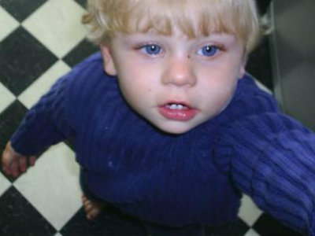
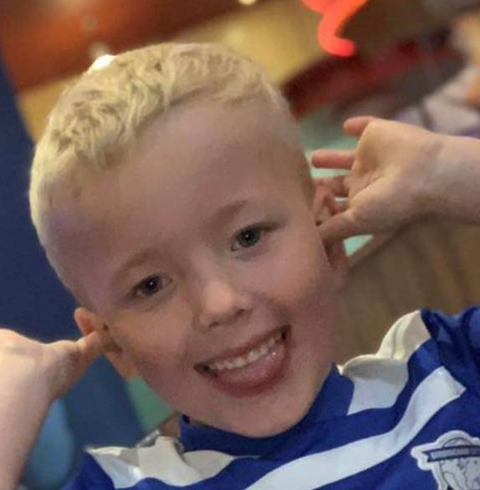
CSPRs
Have you ever heard of a Serious Case Review?
Victoria Climbie, Baby P, Arthur, and more locally in Rochdale, the large review relating to CSE in 2012/2013
Working Together to Safeguard Children 2018 amended the process from Serious Case Reviews to Local Child Safeguarding Practice Reviews
It sets out the process and criteria for the types of cases which must be reviewed
These reviews are facilitated by the safeguarding partnership
Notes:
Current document are being developed in terms of style and presentation – focus has been on the content and what we want in Rochdale
Link to Family Services Model and ensure that the arrangements bring scrutiny and challenge but also support the methodology of working together
Maintain existing partners – working well together, coordinated approach – safeguarding is everyone’s responsibility
CSPR – Rapid Review process is in place and is working. Good liaison with the National Panel (CSDRP) around arrangements, Independent Chair final decision making, timescales met

Slide 11
OUR REVIEW PROFILE
The Rapid Review is the first stage of the review process
We undertake Rapid Reviews when cases meet the below criteria:
abuse or neglect of a child is known or suspected and
the child has died or been seriously harmed
Rapid Reviews have to be completed in 15 working days
All agencies involved with the child and/or family attend the Rapid Review and share their involvement
The aim of a Rapid Review is to decide whether there are immediate actions required to safeguard the child/family, decide what actions are required to policy/practice and to decide whether a Local Child Safeguarding Practice Review should be commissioned
Notes:
Current document are being developed in terms of style and presentation – focus has been on the content and what we want in Rochdale
Link to Family Services Model and ensure that the arrangements bring scrutiny and challenge but also support the methodology of working together
Maintain existing partners – working well together, coordinated approach – safeguarding is everyone’s responsibility
CSPR – Rapid Review process is in place and is working. Good liaison with the National Panel (CSDRP) around arrangements, Independent Chair final decision making, timescales met

Slide 12
ADOUT THE LCSPR AND WHAT IT GIVES US
The review can be lead by an independent author commissioned by the partnership
Part of the review may include a practitioner event
Child and family involvement is a priority (where possible)
Author comes up with recommendations which the partnership should embed
Once a review is completed, the report is signed-off through the Partnership and published on our website for 12 months
Always anonymised!
Notes:
Current document are being developed in terms of style and presentation – focus has been on the content and what we want in Rochdale
Link to Family Services Model and ensure that the arrangements bring scrutiny and challenge but also support the methodology of working together
Maintain existing partners – working well together, coordinated approach – safeguarding is everyone’s responsibility
CSPR – Rapid Review process is in place and is working. Good liaison with the National Panel (CSDRP) around arrangements, Independent Chair final decision making, timescales met

Slide 13
KEY LEARNING FROM REVIEWS
All learning from our reviews is on the RBSCP website (rochdalesafeguarding.com)
The partnership regularly publishes learning briefs specific to reviews and also more thematic learning resulting from issues arising across a number of reviews
Recently our reviews in Rochdale have related to:
SAFE SLEEP (INFANCY)
ABUSIVE HEAD TRAUMA / NON-ACCIDENTAL INJURIES
SEXUAL ABUSE
NEGLECT
Notes:
Current document are being developed in terms of style and presentation – focus has been on the content and what we want in Rochdale
Link to Family Services Model and ensure that the arrangements bring scrutiny and challenge but also support the methodology of working together
Maintain existing partners – working well together, coordinated approach – safeguarding is everyone’s responsibility
CSPR – Rapid Review process is in place and is working. Good liaison with the National Panel (CSDRP) around arrangements, Independent Chair final decision making, timescales met

Slide 14
KEY LEARNING FROM REVIEWS
What are the partnership focussing on now as a result of reviews?
Our recommendations are varied, but some examples are here:
Keeping Baby Safe Campaign – including safer sleep and non-accidental injuries
Identification and responses to sexual abuse
Voice of the child
Escalation when difficulties arise in multi-agency working
Effective response to neglect
Notes:
Current document are being developed in terms of style and presentation – focus has been on the content and what we want in Rochdale
Link to Family Services Model and ensure that the arrangements bring scrutiny and challenge but also support the methodology of working together
Maintain existing partners – working well together, coordinated approach – safeguarding is everyone’s responsibility
CSPR – Rapid Review process is in place and is working. Good liaison with the National Panel (CSDRP) around arrangements, Independent Chair final decision making, timescales met

Slide 15
REVIEWS – FINAL POINTS
Robust action planning process – regularly reviewed
Whole review process has oversight by a national panel of experts – Child Safeguarding Practice Review Panel
Not a blaming exercise, reviews look at what can be developed and also highlight good practice
Feedback from practitioner events is positive!
Notes:
Current document are being developed in terms of style and presentation – focus has been on the content and what we want in Rochdale
Link to Family Services Model and ensure that the arrangements bring scrutiny and challenge but also support the methodology of working together
Maintain existing partners – working well together, coordinated approach – safeguarding is everyone’s responsibility
CSPR – Rapid Review process is in place and is working. Good liaison with the National Panel (CSDRP) around arrangements, Independent Chair final decision making, timescales met

Slide 16
RECAP
Rochdale Borough Safeguarding Children Partnership is there to promote joint working / to ensure it happens effectively
Ultimate goal that safeguarding children in Rochdale remains strong and is always a priority
Constantly striving for safeguarding learning and improvement – achieved by review, training and audit
ANY QUESTIONS?
Notes:
Current document are being developed in terms of style and presentation – focus has been on the content and what we want in Rochdale
Link to Family Services Model and ensure that the arrangements bring scrutiny and challenge but also support the methodology of working together
Maintain existing partners – working well together, coordinated approach – safeguarding is everyone’s responsibility
CSPR – Rapid Review process is in place and is working. Good liaison with the National Panel (CSDRP) around arrangements, Independent Chair final decision making, timescales met

Slide 17
THANK YOU
To contact the partnership:
E-mail address: RBSB.admin@rochdale.gov.uk
Call the team: 01706 927700
Website: rochdalesafeguarding.com
Twitter: LSCPB_Rochdale
Facebook: https://www.facebook.com/LSCPRochdale/
Notes:
Current document are being developed in terms of style and presentation – focus has been on the content and what we want in Rochdale
Link to Family Services Model and ensure that the arrangements bring scrutiny and challenge but also support the methodology of working together
Maintain existing partners – working well together, coordinated approach – safeguarding is everyone’s responsibility
CSPR – Rapid Review process is in place and is working. Good liaison with the National Panel (CSDRP) around arrangements, Independent Chair final decision making, timescales met

