Slide 1

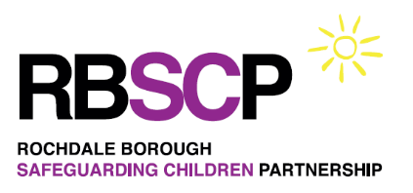
ROCHDALE COMMUNITY SAFEGUARDING FORUM
22 NOVEMBER 2022

Slide 2
Welcome and Housekeeping
Sean Roebuck
Development Officer
Rochdale Borough Safeguarding Adults Board
Rochdale Borough Safeguarding Children Partnership

Slide 3
Agenda

Slide 4
Virtual meeting etiquette
Do set your microphone to mute on the device you are using to minimise background noise
Turn off your camera
Do not interrupt presentations or use the show emotions facility
Comments and questions can be sent via the chat (instant messaging) function
The event is being recorded for training purposes

Slide 5
SELF-NEGLECT & HOARDING
Mary Martins
Team Manager
Adult Care and Support
Rochdale Borough Council

Slide 6
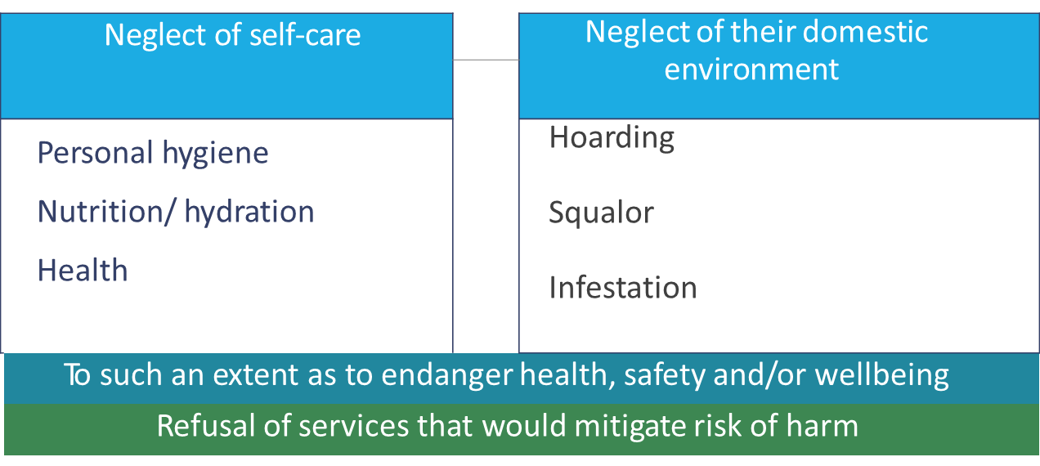
What do we mean by self-neglect?
“Self-neglect: this covers a wide range of behaviour neglecting to care for one’s personal hygiene, health or surroundings and includes behaviour such as hoarding” (DH 2016)
Notes:
5 minutes.
Neglect of self care and neglect of environment
Living in very unclean, sometimes verminous conditions where their home environment has been neglected and impacting on the persons health, wellbeing and safety as well as that of others
• Neglecting household maintenance creating hazard and fire risks
• Neglecting personal hygiene so much so that its impact on the person’s health; for example pressure ulcers
• Poor diet or nutrition
• Lack or Intermittent engagement with support services
• Failure to maintain social contact
• Hoarding – excessive attachment to possessions creating mobility and fire hazards
• Declining or refusing prescribed medication
• Substance misuse
• Large number of pets with potential insanitary conditions and neglecting their needs
• Failure to manage finance
* DSM is the Diagnostic and Statistical Manual of Mental Disorders which was first published in 1952. Since then it has had several revisions at irregular intervals. It is an American publication which is used to a greater or lesser degree around the world by health professionals, insurance companies and pharmaceutical companies. Policy makers also refer to it when making funding decisions.
DSM-IV listed hoarding as a symptom of OCD (Obsessive Compulsive Disorder) and referring to it as 'compulsive hoarding'. But in recent years, researchers found that hoarding did not respond to OCD treatments. This led them to investigate further. The result of various studies has been a move to redefine hoarding in DSM-V as a discrete disorder severing it from OCD and giving it a new name 'hoarding disorder’

Slide 7
What may cause self-neglect?
• Fear of losing control
• Pride in self sufficiency
• Sense of being connected to what surrounds them
• Mistrust of professionals or people in authority
• Social isolation
• Drug and alcohol misuse
• Age related changes in physical or mental health
• Bereavement / traumatic event
• Mental health difficulties
• Targeted by a particular individual, group or gang who have been able to identify their vulnerability
• Fear and anxiety

Slide 8
Risk factors of self-neglect - what are they?
Research has suggested that there are three recognized forms of self-neglect which include:
Lack of self-care –this may involve neglecting personal hygiene, nutrition and hydration or health. This type of neglect would involve a judgement to be made about what is an acceptable level of risk and what constitutes wellbeing.
Lack of care of environment –this may result in unpleasant or dirty home conditions and an increased level of risk in the domestic environment such as health and safety and fire risks associated with hoarding. This may be subjective and require a judgement call to determine whether the conditions within a person’s home are acceptable.
Refusal of services that could alleviate these issues –this may include the refusal of care services, treatment, assessments or intervention, which could potentially improve self-care or care of one’s environment

Slide 9
Why is self-neglect so challenging to practitioners?
Its varied presentation, influenced by a complex mix of personal, mental, physical, social and environmental factors
The high risks it poses, both to the individual and sometimes to others
Service users sometimes do not identify with the description of their situation
The possibility that intervention is not welcomed by the individual, making engagement difficult
The challenges of assessing mental capacity
Ethical dilemmas between respecting autonomy and fulfilling a duty of care
Systems that prioritise short-term, task-focused involvement rather than long-term relationships with service users
The need for coordinated interventions

Slide 10

Ethical dilemmas arise from competing obligations
Respect for autonomy & self- determination
Duty to protect and promote dignity
Human rights principles
Legislation (MCA)
Limitations to state power
Policy context of ‘personalisation’ and making safeguarding personal
Professional codes of ethics
The duty to protect from foreseeable harm
Human dignity compromised
Human rights principles
Risk to others
Notes:
2 minutes

Slide 11
Hoarding – WHAT IS IT?

Slide 12
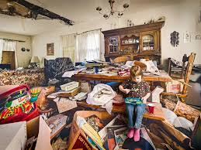
Hoarding
Hoarding is a complex condition where the hoarder has a strong emotional attachment to often multiple objects in excess of their real value. This can be to a level where it impacts on their health, social functioning and potentially on their and other people’s welfare and safety.
Hoarding is not relative to age,
gender, ethnicity, or socio-
economic status, and it can
happen to anyone.
Anything can be hoarded from
material possessions, paper,
animals and sometimes faeces.
Notes:
2 minutes
Hoarding Disorder used to be considered a form of obsessive compulsive disorder (OCD). It is now considered a standalone mental disorder and is included in the 5th edition of the Diagnostic and Statistical Manual of Mental Health Disorders 2013.
Hoarding can also be a symptom of other mental disorders. Hoarding Disorder is distinct from the act of collecting, and is also different from people whose property is generally cluttered or messy. It is not simply a lifestyle choice. The main difference between a hoarder and a collector is that hoarders have strong emotional attachments to their objects which are well in excess of their real value

Slide 13
What are the Risks?
Risk to self and others - both within the household and to neighbours etc
Think Family - risk to children and other family members
Fire Safety
Verminous - relating to rats, mice and other pests including insects, their eggs and larvae
Environmental - hoards of rubbish, rotten food, soiled clothing, faeces. Risk of disease. Foul smells to neighbourhood
Risk to the structural integrity of the property
Physical health and adequate nutrition
Threat to tenancy and risk of homelessness

Slide 14
Fire safety
Hoarding increases the risk of a fire occurring and makes it more difficult for people living within the property to evacuate safely.
Fire can also spread to neighbouring properties if the level of hoarding is severe or if flammable items such as gas containers are being stored. It also poses a high risk to fire fighters when attending the scene
Adults who hoard are at greater risk as there is more material to burn (fire loading )
It is also important to note that fire risks such as poorly maintained appliances, camping type cooking appliances, barbecues, overloaded and worn sockets, the use of candles, smoking in the property all pose a significant fire risk

Slide 15
Supporting legislation
Housing Act 2004
An Improvement Notice or Demotion Order can be obtained if there is a hazard that exists in a building posing a risk of harm posing a risk of harm to an occupier or any dwelling or house in multiple occupations
Power of entry/ Warrant
(s.287 Public Health Act)
Gain entry for examination/ execution of necessary work required under Public Health Act, police attendance required for forced entry
Prevention of Damage by Pests Act 1949
Local authorities have a duty to take action against occupiers if there is evidence of rats or mice

Slide 17
Supporting legislation
Crime and Disorder Act, Section 115
The lawful power for anyone to disclose information to a relevant authority where this is reasonable suspicion of a crime
Fire Safety Order 2005
A Prohibition Notice can be served on a premise such as a house in multiple occupation or a flat (not single occupancy domestic premises) where there is a fire risk that could cause death or serious injury to others. The notice will be served and restrict the use of the premises

Slide 18
Supporting legislations
Power of Entry (S17 of Police and Criminal Evidence Act) Only to be used by the police and in an emergency situation. This is a power to enter premises without a warrant in order to save life and limb.

Slide 19
Making Safeguarding Personal (MSP)
Local Government Association says that MSP seeks to achieve:
• A personalised approach that enables safeguarding to be done with, not to, people
• Practice that focuses on achieving meaningful improvement to people's circumstances rather than just on ‘investigation' and ‘conclusion'
• An approach that utilises social work skills rather than just ‘putting people through a process'
• An approach that enables practitioners, families, teams and SABs to know what difference has been made
Adults will be supported to define the outcomes they desire from their personal circumstances of abuse and neglect. The process is personalised and flexible and can conclude at any stage as appropriate

Slide 20
Legislation- The Mental Capacity Act 2005
Mental capacity should be considered for any assessment and decision making process when considering cases of self-neglect. Capacity is decision and time specific
• There is a presumption of capacity, if there are concerns about a person’s capacity to take relevant decisions a Mental Capacity Act compliant capacity assessment should be completed
• Right to make unwise decisions
• Where it is found that the adult lacks capacity then any actions taken, must be in their best interests and in accordance with the Mental Capacity Act 2005 and the associated Code of Practice

Slide 21
Mental Capacity
Five Principles of the Mental Capacity Act 2005:
1. A person must be assumed to have capacity unless it is established that they lack capacity
2. A person is not to be treated as unable to make a decision unless all practicable steps to help them to do so have been taken without success
3. A person is not to be treated as unable to make a decision merely because s/he makes an unwise decision
4. An act done, or decision made, under this act for or on behalf of a person must be done, or made, in their best interests
5. Before the act is done, or the decision is made, regard must be had to whether the purpose for which it is needed can be as effectively achieved in a way which is less restrictive of the person’s rights and freedom of action

Slide 22
Care Act 2014
The statutory guidance identifies that it can be difficult to assess self-neglect. Specifically, that it may be difficult to distinguish between whether a person is making a capacitated choice to live in a particular way (which may be described as unwise) or whether the person lacks mental capacity to make the decision.
• The Care Act (2014) emphasises the importance of using local community support networks and facilities provided by partner and voluntary organisations.
• The duty to promote wellbeing and making safeguarding personal is central to the Care Act.

Slide 23
If a person is assessed as lacking capacity
When a person has been assessed as lacking capacity, interventions can be made in the person’s best interests.
• In urgent situations where the person lacks capacity and there is imminent, serious risk/danger to the person, an emergency application can be made to the Court of Protection.
• If there is difficulty gaining access to a person, so are unable to assess capacity and the person may be self neglecting, it is possible to apply for inherent jurisdiction through the high court.

Slide 24
Advocacy
Under the Care Act 2014, the local authority must arrange for an independent advocate to represent and support a person who is the subject of an enquiry, if they need help to understand and take part in the enquiry and/or to express their views, wishes or feelings
The person does not need to lack capacity to be entitled to an advocate. The local authority should provide an advocate if there is no-one else who is appropriate

Slide 25
Multi-agency approach
Strategic responsibility for self-neglect is clearly located within a shared inter-agency governance arrangement such as the SAB
• Agencies share definitions and understandings of self neglect
• Inter-agency coordination and shared risk-management is facilitated by clear referral routes, communication and decision-making systems
• Longer-term supportive, relationship-based involvement is accepted as a pattern of work
• Training and supervision challenge and support practitioners to engage with the ethical challenges, legal options and skills involved in self-neglect practice

Slide 26
HOW TO MAKE SAFEGUARDING REFERRAL TO ADULT CARE
The local authority is responsible for the public law decision as to whether or not to carry out a statutory Section 42(2) enquiry. In order to determine this, information gathering needs to take place to establish if the concern meets the Concern Stage S42(1) eligibility criteria
If a decision is made that the safeguarding concern meets the S42(2) a risk assessment MUST be completed within 24 hours, strategy meeting must take place with all professionals involved including the person at risk of harm from their self-neglect
Self-neglect can be quite disturbing and it is important that we refer people early in order to get the necessary support and prevent harm from occurring

Slide 27
COMFORT BREAK
Self-neglect: know the signs: https://www.youtube.com/watch?v=HQP0SfsejpE&t
What is safeguarding and the role of the Rochdale Borough Safeguarding Adults Board (RBSAB)? https://www.youtube.com/watch?v=ZsZnurU3WBo

Slide 28

ROCHDALE BOROUGH SAFEGUARDING ADULTS BOARD
Amanda Clarke – Independent Chair
Helen Heaton – Business Manager
Notes:
This is about us

Slide 29
BACKGROUND
You may have heard of safeguarding adults boards (SAB)?
The Care Act 2014 sets out a clear legal framework to protect adults at risk of neglect or abuse
The main change required 3 Statutory Partners to lead the SAB
  Rochdale Local Authority
  Greater Manchester Police
  Heywood, Middleton and Rochdale Integrated Care Partnership
Notes:
RSCP journey -
Published in early July but with clear requirements for certain tasks to be in place by 29.06.18 – placed a significant amount of pressure on Local Authorities to have arrangements in place immediately
Rapid Review Process – shared with Salford to support a GM approach to Rapid Reviews – working regionally and supporting developments

Slide 30
PURPOSE OF THE BOARD
Ensure all agencies involved in safeguarding adults in Rochdale work effectively
The board will ask for assurance and evidence from safeguarding partners
Boards commit to a multi-agency approach in safeguarding adults
Every year, an annual report is produced to demonstrate the work of the board (find at www.rochdalesafeguarding.com )
Notes:
RSCP journey -
Published in early July but with clear requirements for certain tasks to be in place by 29.06.18 – placed a significant amount of pressure on Local Authorities to have arrangements in place immediately
Rapid Review Process – shared with Salford to support a GM approach to Rapid Reviews – working regionally and supporting developments

Slide 31
THE BUSINESS UNIT
The business unit supports the adults board
Independent chair: Amanda Clarke
There is a business manager: Helen Heaton
There are three development officers: Sean Roebuck, Sam White and Carl Travis
There is one quality assurance officer: Lee Hogan
There are two Administrators: Helen Payton and Lauren Hayes
The business unit can be contacted via: rbsb.admin@rochdale.gov.uk
Notes:
RSCP journey -
Published in early July but with clear requirements for certain tasks to be in place by 29.06.18 – placed a significant amount of pressure on Local Authorities to have arrangements in place immediately
Rapid Review Process – shared with Salford to support a GM approach to Rapid Reviews – working regionally and supporting developments

Slide 32
MULTI-AGENCY APPROACH
We also engage with a number of other agencies including Rochdale Boroughwide House, Rochdale Probation, other health care providers, and representatives from the voluntary sector
The board works closely with RBSCP (Safeguarding Children’s Partnership) which is also chaired by Amanda
The board has close links with Rochdale Community Safety Partnership (RCSP) which is especially important as the RCSP leads on domestic abuse
Notes:
Published in early July but with clear requirements for certain tasks to be in place by 29.06.18 – placed a significant amount of pressure on Local Authorities to have arrangements in place immediately
Rapid Review Process – shared with Salford to support a GM approach to Rapid Reviews – working regionally and supporting developments

Slide 33
WHAT DO WE DO?
There are a number of sub-groups as part of the safeguarding board:
  SAR Sub-Group
  Complex Safeguarding Sub-Group
  Learning, Development and Excellence in Practice Sub-Group
  Communications & Engagement Sub-Group
  Quality Assurance, Practice Review Sub-Group
  Policy and Procedure Sub-Group (Virtual)
Sub groups meet generally quarterly with there own work plans which feed into the overall work plan and priorities for the board
The full board meets bi-monthly where all partners are provided with the opportunity to have oversight and to query the work of the board
Notes:
Current document are being developed in terms of style and presentation – focus has been on the content and what we want in Rochdale
Link to Family Services Model and ensure that the arrangements bring scrutiny and challenge but also support the methodology of working together
Maintain existing partners – working well together, coordinated approach – safeguarding is everyone’s responsibility
CSPR – Rapid Review process is in place and is working. Good liaison with the National Panel (CSDRP) around arrangements, Independent Chair final decision making, timescales met

Slide 34
WHAT DO WE DO?
We undertake SAR screening and facilitate full Safeguarding Adults Reviews
We facilitate multi-agency training courses on a variety of topics (https://rochdalesafeguarding.com/p/training/training-arrangement)
We undertake a variety of audits and analysis projects via the Quality Assurance Sub-Group
We facilitate multi-agency campaigns to raise awareness of safeguarding topics relevant to Rochdale

Slide 35
LEARNING CHECK
Question 1: Name the three Strategic Executive Partner agencies
Question 2: What is the main aim of the safeguarding board?
Question 3: Which partnership is the safeguarding board closely linked to?
Question 4: Name two of the sub-groups of the board
  ANSWERS TO BE WRITTEN IN THE CHAT
Notes:
Current document are being developed in terms of style and presentation – focus has been on the content and what we want in Rochdale
Link to Family Services Model and ensure that the arrangements bring scrutiny and challenge but also support the methodology of working together
Maintain existing partners – working well together, coordinated approach – safeguarding is everyone’s responsibility
CSPR – Rapid Review process is in place and is working. Good liaison with the National Panel (CSDRP) around arrangements, Independent Chair final decision making, timescales met

Slide 36
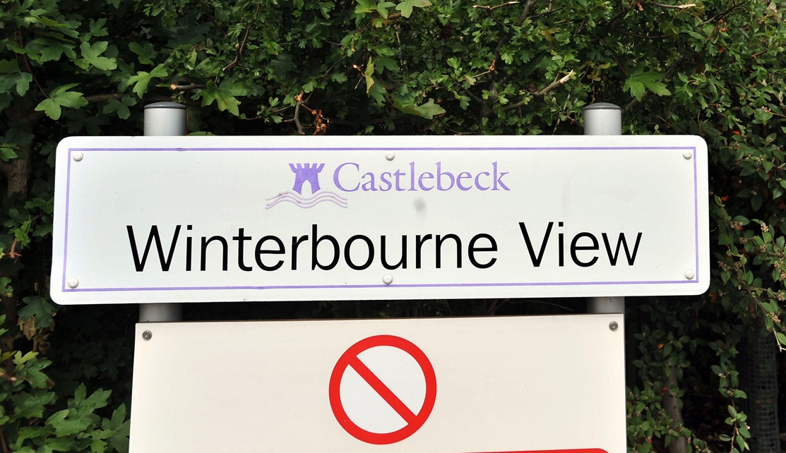
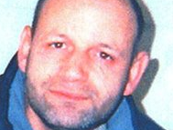
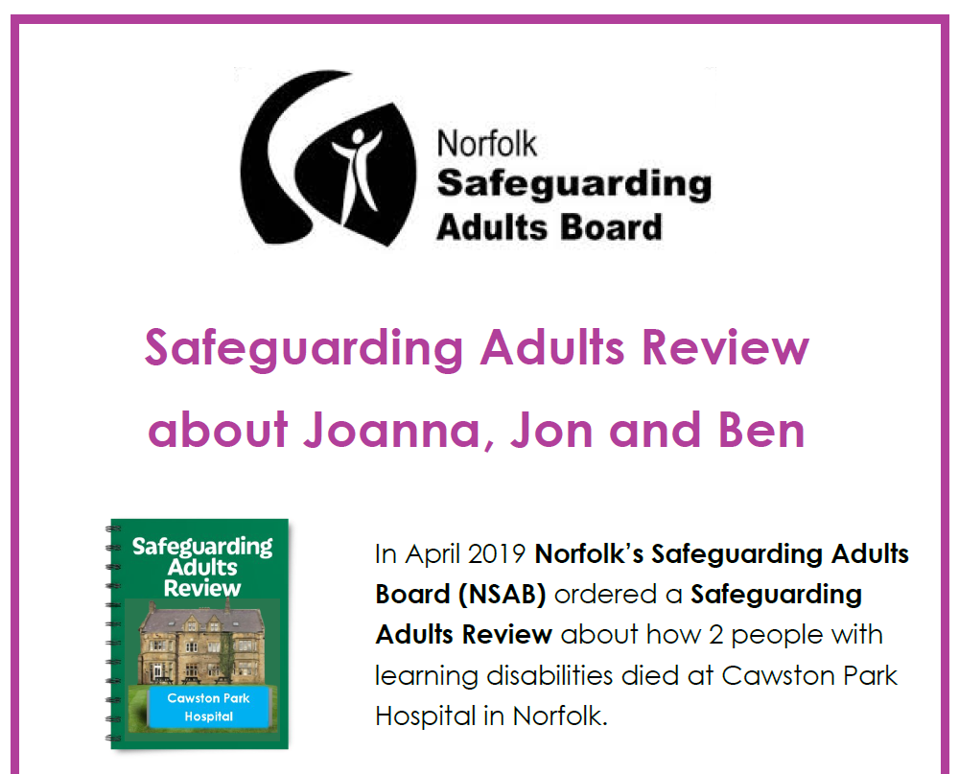
OUR REVIEW PROCESS
  Have you ever heard of a Safeguarding Adults Review?
  National examples include: Winterbourne View, Steven Hoskin (Cornwall), Joanna, John and Ben (Norfolk)
  The Care Act 2014 states that the board must arrange a review (SAR) when an adult in its locality dies or is significantly injured as a result of neglect or abuse and there are areas identified where agencies could have worked together more effectively
  It sets out the process and criteria for the types of cases which must be reviews
  These reviews are facilitated by the safeguarding board
  All Safeguarding Adults Reviews are published
Notes:
Current document are being developed in terms of style and presentation – focus has been on the content and what we want in Rochdale
Link to Family Services Model and ensure that the arrangements bring scrutiny and challenge but also support the methodology of working together
Maintain existing partners – working well together, coordinated approach – safeguarding is everyone’s responsibility
CSPR – Rapid Review process is in place and is working. Good liaison with the National Panel (CSDRP) around arrangements, Independent Chair final decision making, timescales met

Slide 37
SAFEGUARDING ADULTS REVIEW
  An independent author is commissioned by the board to write the report
  Part of the review may include a practitioner event
  Adult and family involvement is a priority (where possible)
  The author comes up with recommendations which the board should embed
  Once a review is completed, the report is signed-off through the board and published on our website for 12 months
  The reports are always anonymised!
Notes:
Current document are being developed in terms of style and presentation – focus has been on the content and what we want in Rochdale
Link to Family Services Model and ensure that the arrangements bring scrutiny and challenge but also support the methodology of working together
Maintain existing partners – working well together, coordinated approach – safeguarding is everyone’s responsibility
CSPR – Rapid Review process is in place and is working. Good liaison with the National Panel (CSDRP) around arrangements, Independent Chair final decision making, timescales met

Slide 38
Safeguarding Adult Review
Adult G
Practitioner Learning Brief
Engagement with Services
Substance misuse services were offered to Adult G, but due to intermittent engagement he did not receive support. Providers of these services try to ensure there is access for those who are resistant to change, but the availability of funding can mean allocating resources for service provision is difficult.
Adult G was offered a referral to Access Team and Thinking Ahead which he refused, he also declined support from Adult Social Care (ASC) to access the community services that he originally stated he would like.
Background
Adult G had a supportive family background, but from the age of 20 frequently used cannabis and later went to on to regularly use heroin and crack cocaine. Adult G initially accessed episodes of drug treatment but his engagement with services was not consistent and he continued to misuse drugs and alcohol to the point where he had significant health issues related to using injectable drugs. He often refused medical treatment and his condition deteriorated until in December 2020 he was admitted to hospital and died at the age of 55 after not responding to treatment for sepsis.
Engagement with Family
Adult G’s sister supported her brother to attend appointments and advocated on his behalf when she was able to.
Professionals engaged with Adult G’s family to try and persuade him to take up the offers of treatment
Self Neglect
Adult G was reluctant to accept support for his ongoing drug misuse and had a lack of ability to put his physical health above his substance misuse needs.
Alcohol and drug misuse led to him suffering from severe leg ulcers, open wounds and deep vein thrombosis. His continued refusal of services saw his condition deteriorate resulting in mobility issue to the point where Adult G was housebound.
On several occasions Adult G had appeared to want to be treated for amputation of his lower leg, however he would put it off to another day or change his mind.
Escalation
Safeguarding referral made in 2019 was not recognised as meeting criteria and was dealt with as under section 9 of the Care Act as a ‘needs assessment’
No legal advice was sought by any agency involved about the ongoing difficulties in getting Adult G to accept care and treatment.
Between December 2019 and January 2020 attempts were made to start a care package,
A Multi Agency Risk Management (MRM) meeting was not convened until November 2020.
Good Practice
There were continued efforts by different professionals to encourage Adult G to engage with his care and treatment plan
Good Practice
The District Nurses did not give up encouraging Adult G to allow them to provide treatment to him. They constantly looked for different ways to help his wounds heal.
Mental Capacity
More than 6 mental capacity assessments were completed by professionals in 2020 and on each occasion they concluded that Adult G had capacity to make decisions about his care and treatment.
Staff working with Adult G considered his right to life balanced against the right to private and family life and recognised they could only treat him with his informed consent.
https://rochdalesafeguarding.com/
April 2022

Slide 39
What did we learn?
A safeguarding referral was initiated in July 2020. This was following a previous safeguarding referral in 2019 which did not progress as it did not meet criteria. An MRM Meeting was convened in November 2020. Prior to this partner agencies had not had the opportunity to discuss information which they held on Adult G, carry out a multi agency risk assessment or put in place a multi agency action.
Partner agencies involved were either not aware of the availability of or did not seek advice from within their organisations on how to use legal powers effectively in their practice to improve the wellbeing of Adult G and help to reduce the harm the non engagement and self neglect was causing
Adult G’s reluctance to accept hospital admission was multi faceted but included concerns about how he would cope with being in hospital when he had no access to substance replacements to manage his drug addiction. There is a referral pathway to support hospitals to manage alcohol and opiate dependence if a patient requires this to allow them necessary access to health care. However there is no legally available replacement to the range of drugs which Adult G was dependant on.
What needs to happen?
Be aware of and know how to escalate concerns about serious self neglect where there is non engagement from the person and the risks to life are increasing.
Understand and be aware of the MRM process as a way to escalate concerns
Be aware of legislation that can be applied to supporting people with drug and alcohol problems who self neglect including the Care Act 2014, the Mental Capacity Act and the Human Rights Act 1998. For more information on their application see How to use legal powers to safeguard highly vulnerable dependent drinkers | Alcohol Change UK
Be aware of how you can seek legal advice from within your individual organisation if you are concerned about a person with care and support needs refusing treatment to the detriment of their health
For cases where there are vulnerable people consider making a referral to the Multi Agency Adult Safeguarding Team to facilitate access to support services for individuals and encourage information sharing.
Consider Peer Support services for people with substance misuse problems. Turning Point offer this type of mentoring by individuals who have gone through similar experiences.
Click here to access the
MRM Protocol
Click here
Rochdale Safeguarding Partnership Board - to access training video on the MRM Process
Click here to access
RSCP Escalation Policy
https://rochdalesafeguarding.com/

Slide 40
KEY LEARNING FROM REVIEWS
  All learning from our reviews is on the RBSAB website (www.rochdalesafeguarding.com)
  The board regularly publishes learning briefs specific to reviews and also more thematic learning resulting from issues arising across a number of reviews
  Recently learning from our reviews in Rochdale has included:
    Self-neglect and substance misuse
    Apparent non-engagement with services
    Suicide linked to domestic abuse
Notes:
Current document are being developed in terms of style and presentation – focus has been on the content and what we want in Rochdale
Link to Family Services Model and ensure that the arrangements bring scrutiny and challenge but also support the methodology of working together
Maintain existing partners – working well together, coordinated approach – safeguarding is everyone’s responsibility
CSPR – Rapid Review process is in place and is working. Good liaison with the National Panel (CSDRP) around arrangements, Independent Chair final decision making, timescales met

Slide 41
KEY LEARNING FROM REVIEWS
  What is the board focussing on now as a result of reviews?
  Our recommendations are varied, but some examples are here:
  Identification and responses to:
  Voice of the adult
  Escalation when difficulties arise in multi-agency working
  Effective response to self-neglect
  Mental capacity
Notes:
Current document are being developed in terms of style and presentation – focus has been on the content and what we want in Rochdale
Link to Family Services Model and ensure that the arrangements bring scrutiny and challenge but also support the methodology of working together
Maintain existing partners – working well together, coordinated approach – safeguarding is everyone’s responsibility
CSPR – Rapid Review process is in place and is working. Good liaison with the National Panel (CSDRP) around arrangements, Independent Chair final decision making, timescales met

Slide 42
REVIEWS – FINAL POINTS
  Robust action planning process are regularly reviewed
  Whole review process has oversight by the SAR Sub Group
  The process is not a blaming exercise, reviews look at what can be developed and also highlight good practice
  Feedback from practitioner events is positive!
  Actions from reviews help to shape board priorities.
Notes:
Current document are being developed in terms of style and presentation – focus has been on the content and what we want in Rochdale
Link to Family Services Model and ensure that the arrangements bring scrutiny and challenge but also support the methodology of working together
Maintain existing partners – working well together, coordinated approach – safeguarding is everyone’s responsibility
CSPR – Rapid Review process is in place and is working. Good liaison with the National Panel (CSDRP) around arrangements, Independent Chair final decision making, timescales met

Slide 43
RECAP
  Rochdale Borough Safeguarding Adults Board is there to promote joint working / to ensure it happens effectively
  Ultimate goal that safeguarding adults in Rochdale remains strong and is always a priority
  Constantly striving for safeguarding learning and improvement – achieved by review, training and audit
  ANY QUESTIONS?
Notes:
Current document are being developed in terms of style and presentation – focus has been on the content and what we want in Rochdale
Link to Family Services Model and ensure that the arrangements bring scrutiny and challenge but also support the methodology of working together
Maintain existing partners – working well together, coordinated approach – safeguarding is everyone’s responsibility
CSPR – Rapid Review process is in place and is working. Good liaison with the National Panel (CSDRP) around arrangements, Independent Chair final decision making, timescales met

Slide 44





THANK YOU
  To contact the board:
  E-mail address: RBSB.admin@rochdale.gov.uk
  Call the team: 01706 927700
  Website: rochdalesafeguarding.com
  Twitter: LSCPB_Rochdale
  Facebook: https://www.facebook.com/rochdalesab
Notes:
Current document are being developed in terms of style and presentation – focus has been on the content and what we want in Rochdale
Link to Family Services Model and ensure that the arrangements bring scrutiny and challenge but also support the methodology of working together
Maintain existing partners – working well together, coordinated approach – safeguarding is everyone’s responsibility
CSPR – Rapid Review process is in place and is working. Good liaison with the National Panel (CSDRP) around arrangements, Independent Chair final decision making, timescales met

Slide 45
PROBATION SERVICE
Janice France
Assistant Chief Officer
Probation Service – Greater Manchester
Bury Rochdale

Slide 46
Safeguarding Forum November 2022
Janice France
Assistant Chief Officer
Probation Service – Greater Manchester
Bury Rochdale

Slide 47

Probation – Our Role
Reducing Re-offending
Public Protection
7

Slide 48
Identifying and Responding to Safeguarding Needs and Risks
Victim Contact Service
Sentence management – people who offend against children/vulnerable adults
Home visits
MAPPA
Safeguarding Partnership engagement
Notes:
VCS – 12 months or more in custody; in pilot for implementation in 2023 all those sentenced to 1 or more days in custody for a domestic abuse offence
Sentence plans – responsive objectives to address risk and engage individuals with specialist services to address factors directly underpinning instability and offending – GMIRS; programme interventions
Licence conditions
Liaison with police – SOMU; OCG colleagues and social care
Liaison with health partners
PoPs families – impact of offending, imprisonment, type of offending and non-contact/further assessments to ensure safe contact (can use CSE family example)
Reintegrative in approach – unpaid work in the community – reparation for harm caused

Slide 49
Any Questions?

Slide 50
EARLY BREAK – Family services OFFER
Julie Burgess
Family Worker
Holding Families + Rochdale
Early Break

Slide 51
Family Services
Working together towards positive change

Slide 52
Our 'Family Services' provide whole family support
for children and family members affected by parental substance misuse. Interventions are centred around the voice of the child. We work with parents and carers at any stage of their recovery from drugs and alcohol use
Our support may begin with drug and alcohol misuse but offers a progressive holistic approach addressing many areas of families’ needs.
e arlybreak.co.uk
E arly Break UK @EarlyBreakUK
e arlybreakuk

Slide 53
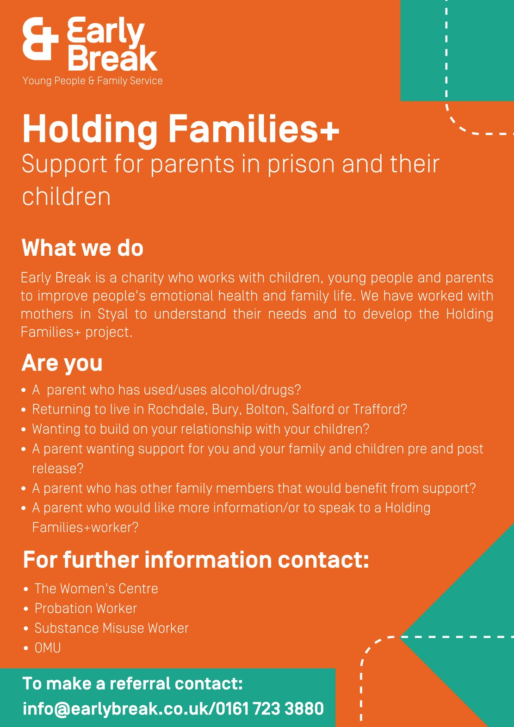
Holding Families+ Programme
Holding Families+ work with children and families of alcohol and substance dependent parents who are in prison. The service is delivered across Rochdale, Bury, Bolton, Salford and Trafford. The project works with mothers in HMP Styal and fathers in HMP Forest Bank to provide pre and post release support.
80%
Improvement in school
attendance
The service recognises the multiple and complex needs of such parents, children and families and why alcohol (and other substances) may have been used previously. It aims to improve emotional and mental health and reduce family conflict to improve children and family outcomes in the short term and intergenerationally. Holding Families+ is a whole family approach which recognises the differing individual needs and aspirations of all family members.
For more information about our Holding Families Programme, or to refer a family, please contact us directly on 0161 723 3880/info@earlybreak.co.uk
To visit our Holding Families+ Programme page on the Early Break website, please click H ERE.
100%
Reduction in parents' self-
harming behaviours
To download a printable PDF version of the poster, please click on the poster image

Slide 54
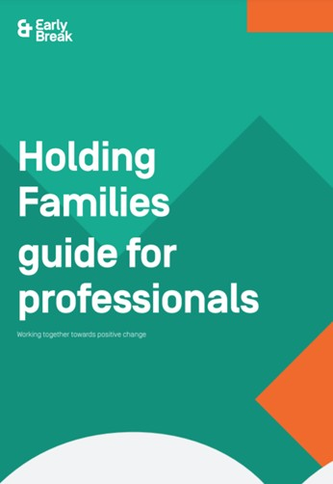
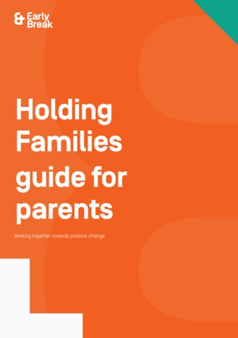
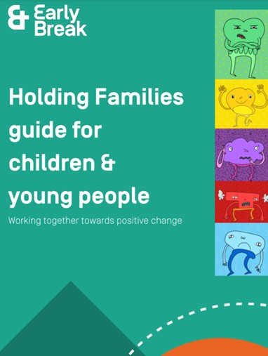
Holding Families Programme
The award winning Holding Families Programme provides whole family support for children and family members affected by parental substance misuse. We also work with families where the parents are on a community order with Probation. We offer support to parents and carers at any stage of their recovery from drugs and alcohol use.
72%
Reduction in Domestic Abuse
We work with each family member separately and also as a family unit. We will work with families where there is at least one young person under the age of 18 living in the family home or where the substance using parent is pregnant. At least one of the parents should have problematic drug or alcohol use. Families can be referred by themselves or by any professional working with them.
The aim of the Programme is to give the whole family the opportunity to talk about any problems caused by drugs and alcohol and to allow the children’s voices to be heard by the family. Ultimately, the Programme aims to empower families to make positive decisions on the changes they would like to make to help improve family life.
82%
Improvement in children and young people's emotional health and wellbeing
For more information about our Holding Families Programme, or to refer a family, please contact us directly on 0161 723 3880/info@earlybreak.co.uk
To visit our Holding Families Programme page on the Early Break website, please click H ERE.
For more information that best suits your needs, please click on the image below:

Slide 55




Like all charities, Early Break relies on the goodwill of volunteers and fundraisers to support them. If you would like to help Early Break at events, pre-event organisation, administration, corporate sponsorship, third party fundraising and much more, please get in touch.
If you would like to make a donation to our charity now which would be both appreciated and valued, please click H ERE.
info@earlybreak.co.uk T: 0161 723 3880
F: 0161 723 5544
For more information about drugs and alcohol visit our microsite:
dontbeazombie.co.uk
Early Break Annara House 7-9 Bury Road Radcliffe
M26 2UG
For more information about understanding emotions visit our microsite: m emotional.co.uk
earlybreak.co.uk
Registered Charity Number: 1072052 A Non Profit Making Company Limited by Guarantee. Company Number: 3320039

Slide 56
SAFEGUARDING board and partnership UPDATES
Sean Roebuck
Development Officer
Rochdale Borough Safeguarding Adult Board
Rochdale Borough Safeguarding Children Partnership

Slide 57
SAFEGUARDING ADULTS WEEK 2022
Principal focus of the week: self-neglect
Key priority for us all in Rochdale
Week aimed at everyone within the borough
Raise awareness of how to spot the signs, how to report concerns, as well as offering training and resources
RBSAB social media: Facebook: @rochdalesab Twitter: @LSCPB_Rochdale
YouTube: Rochdale Safeguarding Board and Partnership
RBSAB webpage: https://rochdalesafeguarding.com/p/news/safeguarding-adults-week-2022
E-newsletter: https://rochdalesafeguarding.com/p/news/newsletters
Public and practitioners consultations

Slide 58
SAFEGUARDING BOARD AND PARTNERSHIP WEBSITE AND TRAINING OFFER
RBSAB and RBSCP joint website: rochdalesafeguarding.com
Single resource for all our safeguarding multi-agency resources including policies, procedures, tools, training and information
Complies with accessibility legislation and can be viewed on all devices and browsers
Training section – ‘book a course’ link
Free of charge for anyone who works or volunteers in the Rochdale borough
Most currently delivered online
New booking system

Slide 59
ANY OTHER BUSINESS?

Slide 60
Thank you for attending and your participation

