Slide 1
Safeguarding Adults
Jayne Todd
Allegation Management Lead/Best Interest assessor/AMHP
Nov 2019

Slide 2
Safeguarding Adults
Safeguarding Adults is now enshrined in Legislation and is part of the Care Act 2014.
The new Act stipulates that all local authorities must:
lead a multi-agency local adult safeguarding process
make enquiries into Safeguarding concerns, or cause others to do so
establish Safeguarding Adults Boards, statutory agencies are local authority, NHS and police
carry out Safeguarding Adults Reviews when someone with care and support needs dies or is severely harmed as a result of neglect or abuse.
arrange for an independent advocate to represent and support a person who is the subject of a safeguarding enquiry or review, if required.

Slide 3
Which Adults might we need to Safeguard?
Notes:
An Adult to whom these Policy and Procedures apply is someone who:
has needs for care and support (whether or not the local authority is meeting any of those needs) and;
is experiencing, or at risk of, abuse or neglect; and
as a result of those care and support needs is unable to protect themselves from either the risk of, or the experience of abuse or neglect.
The Adult may be a person who:
is elderly and frail due to ill health, physical disability or cognitive impairment
has a learning disability
has a physical disability and/or a sensory impairment
has mental health needs including dementia or a personality disorder
has a mental disorder such as anxiety
has a long-term illness/condition
misuses substances or alcohol
is a carer such as a family member/friend who provides personal assistance and care to Adults and is subject to abuse
is unable to demonstrate the capacity to make a decision and is in need of care and support.
(This list is not exhaustive.)

Slide 4
The Care Act 2014…….
In the context of the legislation, the eligibility criteria for safeguarding duties applies to any adult (over the age of 18) who:
Has needs for care and support (whether or not the authority is meeting any of those needs)
(b) Is experiencing, or is at risk of, abuse or neglect, and
(c) As a result of those needs is unable to protect himself or herself against the abuse or neglect or the risk of it.

Slide 5
Care Act 2014 Six principles of Adult Safeguarding
There are six principles of adult safeguarding:
Empowerment: presumption of person-led decisions and informed consent
Protection: support and representation for those in greatest need
Prevention: taking action before harm occurs
Proportionate and least intrusive responses: appropriate to the risk
presented
Partnership: local solutions through services working with their communities
Accountability: accountability and transparency in delivering safeguarding.

Slide 6
Making Safeguarding Personal
A Safeguarding enquiry should establish whether any action needs to be taken to prevent or stop abuse or neglect, and, if so, by whom.
‘Making Safeguarding Personal’
is shifting the focus of adult safeguarding work towards a person centred approach, and working towards outcomes that the person wants to help them manage the risk of abuse and/or neglect.

Slide 7
Psychological
emotional
Discriminatory
Sexual
Child Sexual
Exploitation
Physical
Neglect and acts of omission
Domestic violence
Modern Slavery/ Trafficking
Exploitation
FGM (Female Genital Mutilation)
Organisational
Self Neglect
Financial or Material
Honor Based Violence
Intrafamilial
sexual
And More…
Notes:
Types of Abuse
Go over signs & symptoms of abuse
Flipchart exercise
**Print out article about Rochdale’s 2018 Modern Slavery Case
Create Scenarios and create abuse circles that they can stick on.

Slide 8
Tell me about your Safeguarding Adults experience?
Notes:
- Talk about ‘ who has responsibility for Safeguarding’ *** Everyone’s Business

Slide 9
Who can an abuser be?
Anyone can abuse an adult with Care and Support needs. This includes:
partners
relatives
friends and neighbours
other users of a service
someone paid to provide a health or social care service
volunteers
strangers
Most abusers are people already known to the Adult with care and support needs but some people will deliberately exploit or harm individuals who they see as easy targets.

Slide 11
Responding to a concern
When a referral is made into Adult Care, there is a responsibility to consider whether the Safeguarding Concern meets the eligibility for a s42 enquiry. This decision is made by Adult Care Services.
You can make a referral by contacting:
Rochdale Adult Care: 0300 303 8886
Safeguarding adults from abuse or neglect is everyone’s business
Don’t ignore your concerns always refer in.
It is the Local Authorities decision at that point to decide how the concern will be managed.
If there is immediate danger or someone needs urgent medical attention call the emergency services (999).
If you think a criminal offence has been committed inform the police.
Notes:
Discuss how to report a Safeguarding concern

Slide 12
What is Managing Allegations?
A suspicion or concern that a trusted individual within an organisation or establishment has mistreated or abused an adult with care and support needs or may be about to do so.
Notes:
Ensure explain that this process is for employees of the agency (Trusted individuals) – not service user and service user.

Slide 13
Threshold……
The procedure is followed when there is concern that a person who works with adults with care and support needs may have:
Behaved in a way that has harmed, or may have harmed an adult or child
Possibly committed a criminal offence against, or related to, an adult or child
Behaved towards an adult or child in a way that indicates they may pose a risk of harm to adults with care and support needs.
Has the person acted with intent?

Slide 14
Managing Allegations
In April 2018 the local authority devised a process known as Allegation Management where by any allegation made against ‘someone in a position of trust’ against Adults with care and support needs was dealt with separately to Safeguarding. There is some interaction between the two at times.
All provider agencies in the borough are signed up to the RBSAB policies and procedures and have a duty to follow the process.
The guidance for ‘Managing Allegations against people in a position of trust’ is contained within section 14 of the Care and Support Statutory Guidance - GOV.UK
Providers are empowered to make decisions about their employees and attend meetings where they are on an ‘equal’ footing to other agencies
who might be involved.

Slide 15
Why do we need this process?
Shared Information
Support from other agencies involved
Helps providers with decision
Making around risk
Provides structure and clear pathways
Better communication between partners
Strategy Meetings are confidential settings

Slide 16
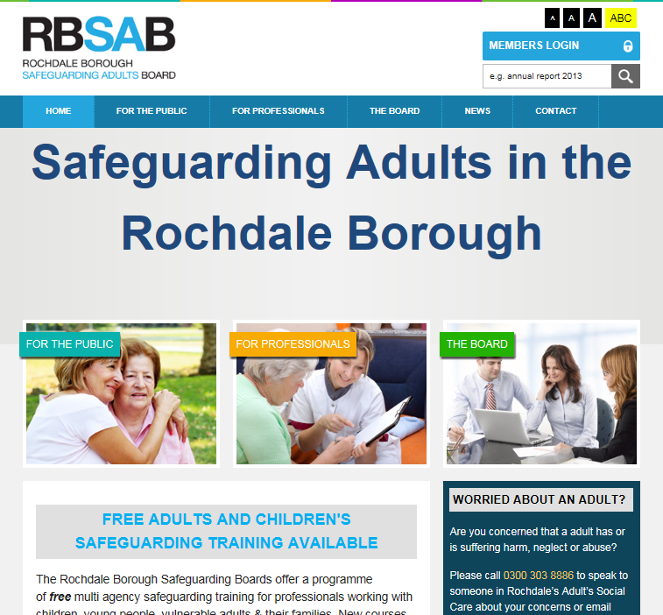
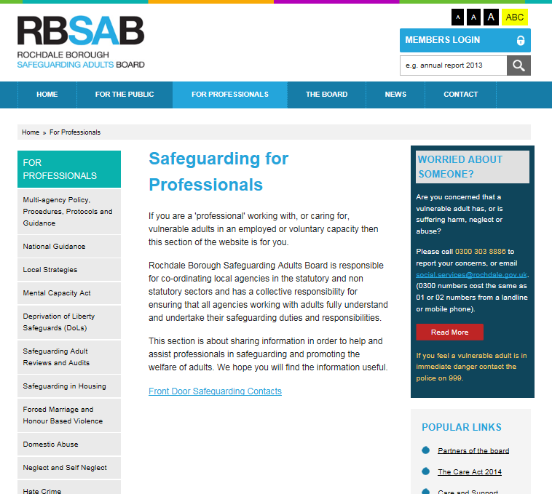
How to find the Multi-Agency Policy and Procedures
www.rbsab.org

Slide 17
In summary……………
Safeguarding concern
Refer in any concerns in relation to Safeguarding Adults
Section 42 enquiry
Safeguarding is everybody’s business
Care Act 2014
RRBSAB website for information
Managing Allegations process in place

Slide 18
Policies & Procedures
www.rbsab.org
Notes:
Give out RBSAB handout

