Slide 2
Project Choice
Supporting those affected by honour based violence and abuse across Greater Manchester

Slide 3
Project Choice
Providing practical and emotional support for those affected by all forms of Honour Based Violence and Abuse and forced marriage
We work with all victims regardless of age, gender and sexual orientation
We work across Greater Manchester and all our services are FREE of charge
The project is a two year pilot project funded by the Manchester Mayor’s Office
The project provides specialist, locally based, one-to-one, culturally appropriate services.
Notes:
Why project Choice:
Victims of HBV/A felt they weren’t getting the right support to enable appropriate responses.
Professionals working with victims needed additional expert advice to respond to HBV/A
Following increased awareness and changes in legislation there was an increase in cases
Support services for HBV/A, particularly FM, were not based in Greater Manchester and there was a need for local services
There is a need for a standardized approach across Greater Manchester
Independent, victim-led service providing follow on support to enable victims to feel empowered to make safe choices

Slide 4
What can Project Choice offer you?
Work in a multi-agency approach; with social services, IDVAs, police, etc.
Assess risk, threat and harm for all individuals involved in cases.
One to one support for victims.
Advocacy and advice for victims.
Telephone and email advice for professionals.
Attend strategy meetings providing specialist overview and recommendations.
Attend Legal Planning meetings.
Attend MARAC meetings when appropriate.
In-depth training to professionals free of charge through Greater Manchester (healthcare, police, Immigration, local authority)

Slide 5
So-called Honour Based Violence and Abuse
“Honour Based Abuse and Violence. Embraces a variety of crimes of violence (mainly but not exclusively against women), including assault, imprisonment and murder where the person is being punished by their family of their community. They are being punished for actually, or allegedly, undermining what the family or community believe to be the correct code of conduct.”
The Right to Choose: Multi-Agency Statutory Guidance for dealing with Forced Marriage ( 2014)
Honour based abuse and violence does not discriminate on race, religion, or culture. These hidden crimes can affect people from all communities.
Honour can be known by many names – Izzat, Abaroo, Sharaf, Sharam, Maryada
Dishonourable actions can include: inappropriate clothes, drugs and alcohol, being in a relationship, pregnancy outside of wedlock and homosexuality
Notes:
Honour killing’ is normally a collective crime where several members of the family or community are usually involved
A family meeting would normally take place to organise an honour killing, to decide who will kill and how
Honour killings are deemed to be an accepted act within certain communities where perpetrators will be looked upon with respect
Perpetrators of honour killings rarely have any sympathy or regret
The victim’s existence will be denied
There is no grieving for the death of the victim
Honour killing is seen as the most final way of cleansing the family of their shame

Slide 6
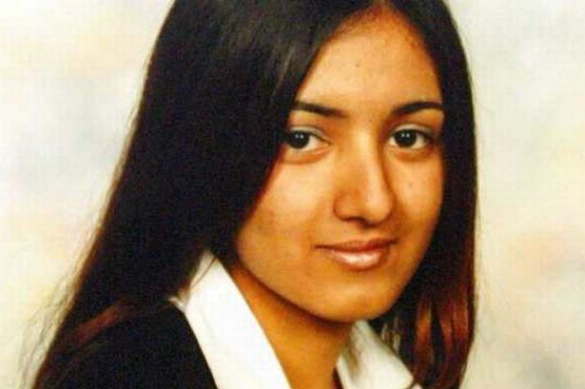
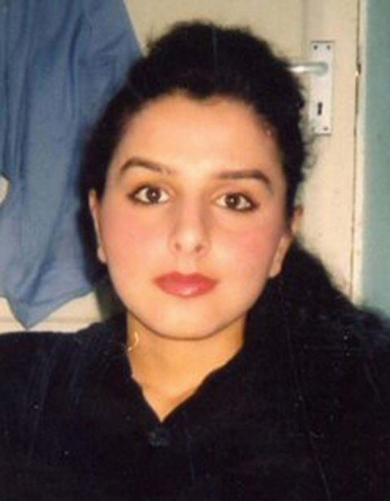
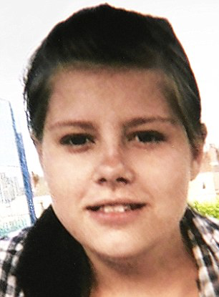
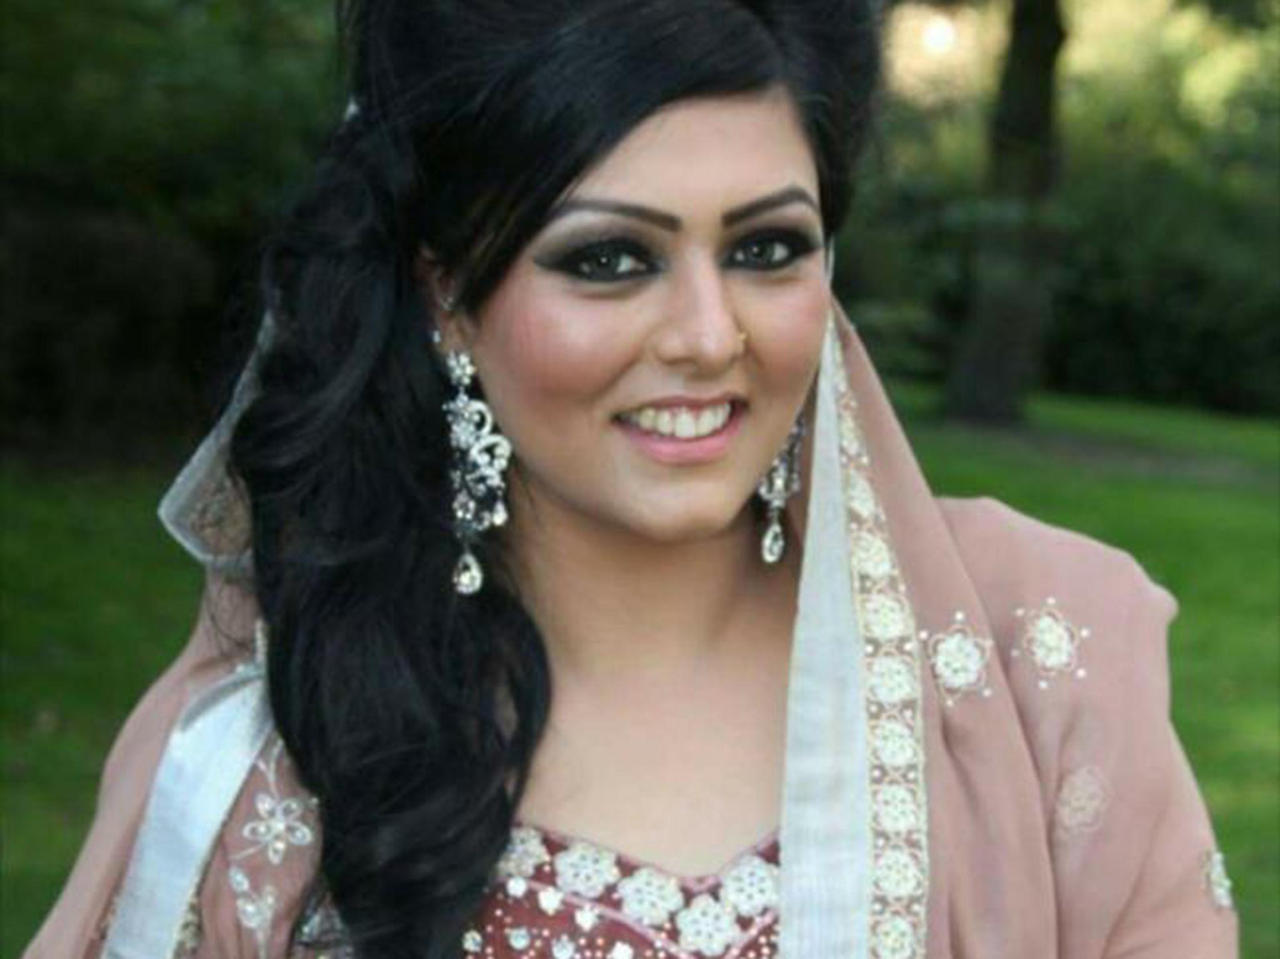
Honour Killings
Shafilea Ahmed (2003):
Murdered by parents for being too ‘westernized’
Banaz Mahmod (2006):
Raped and murdered for walking out of a forced marriage
Laura Wilson (2010):
Murdered by boyfriend for revealing their relationship to his parents
Samia Shahid (2016):
Murdered by father and ex-husband for getting a divorce.
Notes:
https://www.bbc.co.uk/news/uk-39485348
https://theconversation.com/the-forgotten-male-victims-of-honour-based-violence-96041

Slide 7
Forced Marriage
“a forced marriage is when one or both of the spouses do not consent to the marriage and duress is involved. Duress includes physical, emotional and psychological pressure.” UK Government
In 2017 the FMU dealt with 1,196 cases
FM may take place to control unwanted behaviour and sexuality, financial gain, providing care for a vulnerable adult and immigration.
Legislation against FM has existed since 2007, however it was made a criminal offence in 2014.
FM Protection Orders exist to protect victims and these can be obtained by third parties.

Slide 8
Coercive and Controlling Behaviour
“Controlling or coercive behaviour does not relate to a single incident, it is a purposeful patter of behaviour which takes place over time in order for one individual to exert power, control or coercion over another”
Home Office – Statutory Guidance
Challenges around understandings of ‘consent’ and ‘choice’
Consent must be informed
Some vulnerable adults lack the capacity to consent
How does someone get supported to be able to recognize their experiences and say no
Honour based violence cases have coercive control elements – which the victim or the perpetrators might not recognize
It’s important to look past a specific action and consider both the motivation behind the action and how the person involved feels

Slide 9
Project Choice GM Data
354 cases responded to since April 2017
177 cases involving forced marriage
281 cases involving Honour Based Violence
20 cases involving FGM
72 FMPO applied for
59 clients added to the HBV database

Slide 10
Quarter | Number
Jan – Jun 17 | 5
Jul – Sept 17 | 9
Oct – Dec 17 | 12
Jan – Mar 18 | 51
Apr – Jun 18 | 48
Jul – Sept 18 | 57
Oct – Dec 18 | 68
Jan – Mar 19 | 69
Apr – May 19 | 35

Slide 11
Borough Breakdown
Borough | Number | Borough | Number
Bolton | 29 | Salford | 6
Bury | 18 | Stockport | 9
Manchester | 82 | Tameside | 10
Oldham | 166 | Trafford | 1
Rochdale | 29 | Wigan | 4

Slide 12
Referring Agency
Referring Agency | Number | Borough | Number
Children’s Social Care | 113 | Health | 21
Police | 59 | Other | 19
DV service | 51 | Self-referral | 17
Education | 42 | Legal | 5
Adult Social Care | 23 | Housing | 4

Slide 13
Ethnicity
Ethnicity | # | Ethnicity | # | Ethnicity | #
Pakistani | 218 | Iraqi | 5 | Irish - traveller | 1
Bangladeshi | 55 | Libyan | 3 | Moroccan | 1
Romanian | 14 | Iranian | 2 | Syrian | 1
Indian | 7 | Guinea Bissau | 2 | Saudi Arabian | 1
Afghani | 7 | Kuwaiti | 2 | Mixed Race | 1
Kurdish | 6 | DRC | 2 | White British | 1
Nigerian | 6 | Egyptian | 1 | Unknown | 7
Somali | 5 | Eritrean | 1
Black African | 5 | Hungarian | 1

Slide 14
Age | Number
0 – 11 | 12
12 – 13 | 17
14 - 15 | 34
16 - 18 | 83
19 - 25 | 75
26 - 30 | 47
31 - 39 | 51
40 – 49 | 22
50+ | 3
Unknown | 6

Slide 15
Project Choice GM data
53 (15%) clients were asylum seekers, refugees or NRPF
18 (5%) clients were male
6 (2%) LGBT client
28 (8%) of the clients stated that they had a disability
75 (21%) clients also identified as having mental health issues or seeking support for their mental health
13 (4%) clients also had substance misuse issues

Slide 16
Rochdale and HBVA
29 cases responded to since Nov 2017
Referring Agency:
10: Children’s Social Care
6: Police
3: Self-referral, Health, DV Service
2: Other
1 each from Education and Adult Social Care
Ethnicity:
24: Pakistani
3: Bangladeshi
1 male client
4 clients NRPF
7 clients were pregnant; 5 of which were concealed
10 clients also identified as having mental health issues
4 clients had substance misuse issues
3 FMPOs obtained
3 clients supported with housing or homeless prevention
4 clients added to HBV database

Slide 17
One Chance Rule
“You may only have the one chance to save a person’s life so get as much information as you can in the one chance you may ever have”
Manchester Safeguarding Board’s: One Chance Rule
Manchester’s Forced Marriage and ‘so called’ Honour Based Violence and Abuse Protocol 2018

Slide 18
Key Points on HBV/A
One Chance Rule should always be used when working with victims of HBV and FM (condensed version – refer to GMP Intranet for full details)
See victims on their own – this should be done immediately and in secure and private place
Reassure the victim about confidentiality
Accept what is being said to you;
Explain to the victim options and possible outcomes. Respect their wishes
Obtain full details of the victim and provide them with contact details for support
Agree a safe way to make contact
Refer the case to the relevant person/agency
Consider the need for immediate police involvement, protection and placement away from family
It is important to never mediate between victims of HBV/FM and their family

Slide 19
How to refer into Project Choice
Email:
projectchoice@oldham.gov.uk
Phone:
0161 770 2999
Website:
www.oldham.gov.uk/projectchoice
Referrals taken from all statutory agencies, third sector and self referrals

