Slide 1
Domestic Violence & Abuse
Jaria Hussain-Lala
Early Help Domestic Abuse Officer

Slide 2
What is domestic abuse?
Physical abuse
Sexual abuse
Financial abuse
Coercive control /Controlling behaviour
Digital / online abuse
Honour-based violence
Forced marriage
Female genital mutilation (FGM)
Notes:
10 MINS
Ask group what they think domestic abuse is, then reveal and go over the bullet points one by one.
Physical abuse: kicking, punching, slapping, burning, pulling hair, throwing objects, strangulation
Sexual abuse: rape, sexual assault, being made to watch porn/sleep with other people
Financial abuse: controlling all the money, gambling family assets, using some-one names for debt/credit
Ccoercive control is when a person, repeatedly behaves in a way which makes you feel controlled, dependent, isolated or scared. The following types of behaviour are common examples of coercive control: isolating you from your friends and family/community. Taking your phone away. Or changing passwords to your iPad or laptop so you can't use them. This could include any form of restricting access to communication, information or services.
Controlling behaviour is: a range of acts designed to make a person subordinate and/or dependent by isolating them from sources of support, exploiting their resources and capacities for personal gain, depriving them of the means needed for independence, resistance and escape and regulating their everyday behaviour. Chronic criticism—even if it's 'small' things, Veiled or overt threats, against you or them threats to harm themselves/children if they left….
emotional abuse: act or a pattern of acts of assault, threats, humiliation and intimidation or other abuse that is used to harm, punish, or frighten their victim.
Digital / online abuse: monitoring of social media profiles or emails, abuse over social media such as Facebook or Twitter, sharing intimate photos or videos without your consent, using GPs locators or spyware.
Honour-based violence: Social ostracism, Denied access to children, Pressure to go/move abroad, House arrest and excessive restrictions of freedom, Denied access to the telephone, internet, or passport/key documentation
Forced marriage: when parents, family members or other people in the victim's community coerce a girl, boy, woman or man to enter into marriage against their will. Not the same as arranged marriage
Female genital mutilation (FGM): cutting/injuring of female genitals – no health benefits, very dangerous, no religious reasons

Slide 3
DVA Overview of session
Consider how to recognise Domestic Abuse (DA)
Consider some barriers to disclosure
Impact on adults/children
Dealing with a disclosure
Where to get Help

Slide 4
Domestic Abuse: Facts & Figures
62% of children living with domestic abuse are directly harmed by the perpetrator of the abuse, in addition to the harm caused by witnessing the abuse of others
On average victims at high risk of serious harm or murder live with domestic abuse for 2-3 years before getting help
2 women per week are killed by their partner/ex-partner
There is usually 35 incidents of Domestic Abuse before a victim reports the abuse to the police
The police receive a domestic violence-related call every 30 seconds.
Cost £66 Billion per year, criminal justice, health, employers, housing, social care
Notes:
Has more repeat victims than any other crime
400 people commit suicide each year who have attended hospital for domestic abuse injuries in the previous 6 months (200 commit suicide on the day they are discharged)

Slide 5
Local Statistics
Since August 2011 there have been 13 domestic homicide reviews in Rochdale
Since 2012 there have been 16 serious case reviews – 50% of these had DV as a factor, Learning includes: recognising the signs, understanding and responding to domestic abuse and considering the impact of on a child/young person.
In 2018:
There were 3286 Police DV incidents, 66% had children present
66% of the child protection plans initiated had DV as a feature
59% of children taken into Local Authority care had DV as a feature
Notes:
5 MINS
Go over each bullet point on the slide – brief details below:
Domestic Homicide Review (DHR) is a multi-agency review of the circumstances in which the death of a person aged 16 or over has, or appears to have, resulted from violence, abuse or neglect by a person to whom they were related or with whom they were, or had been, in an intimate personal relationship, or a member of the same household
Serious case reviews ( SCRs ) are undertaken by local safeguarding children boards ( LSCBs ) for every case where abuse or neglect is known - or suspected - and either: a child dies. a child is seriously harmed and there are concerns about how organisations or professionals worked together to protect the child

Slide 6
Impact on Adults
Increased mental health issues
Homelessness
Substance misuse
Poor health physical health
Impact parenting
Strong correlation of Debt and Domestic abuse
Learning/employment

Slide 7
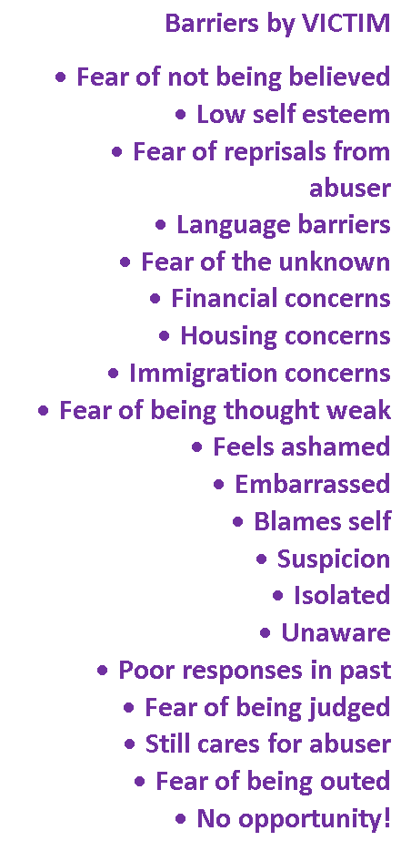
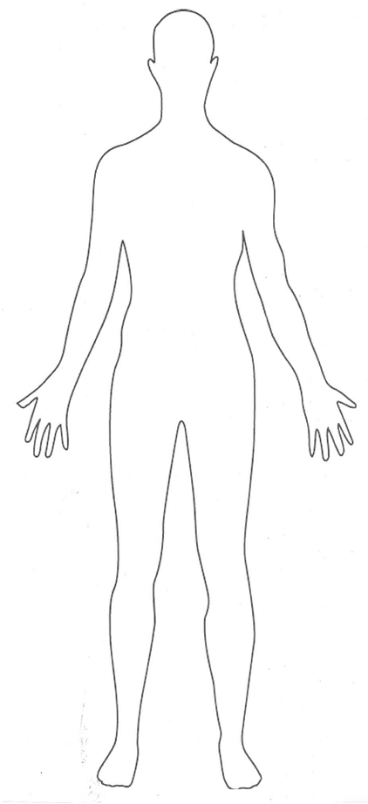
Why didn’t I ask for help?
Notes:
TRAINERS NOTES –
Exercise Instructions – 5 mins & 5 mins discussion
Ask the group to come up with reasons why an individual might be unable to disclose domestic abuse
At end Explain that this exercise demonstrates that there are lots of obstacles and hurdles for a victim to face when they are thinking about making a disclosure and it is important we are there to support family and friends if they talk to you about DA.

Slide 8
Why don’t they just leave?
Losses
Home/House
Family Life
Job
Belongings
Safety
Relationship
Support Network
Friends/family
Familiarity
Gains
Peace of mind
Freedom
New home
New job
New belongings
Safety
New relationship
New friends
New support network
Notes:
Still the first question most people will ask.
Also one of the question that victims ask themselves.
Make the point that the gap between losing nearly everything important (job, home, relationship etc.) and getting it back again with maybe freedom and peace of mind and safety thrown in too is BIG and scary. This is why it is so hard to leave even a damaging and dangerous relationship behind and also why it is vital to have support along the way.
Animation on this slide

Slide 9
Impact on Children & Young People
According to the Department of Health, at least 750,000 children a year witness Domestic violence. There are 130,000 children in the UK living in homes with domestic abuse where there’s a high risk of murder or serious harm. Thousands more live with less serious domestic abuse every day. This has a serious impact on children, and their health and wellbeing
Nearly 2 in 3 children (62%) exposed to domestic violence were also directly harmed
Children can witness Domestic Abuse in a variety of ways:
They may be in the same room and may get caught in the middle of an incident, perhaps in an effort to make the violence stop;
They may be in another room but be able to hear the abuse or see their mother or fathers physical injuries following an incident of violence; or they may be forced to take part in verbally abusing the victim.

Slide 10
Impact on Children and Young People
Children are often more aware of problems than parents realise
Children worry about their parents
Children mainly use informal support
Children do not know where to go to get formal help
Experience of contact with professionals is mixed
Some children will not talk to anyone about their problems & cope by distracting themselves
Notes:
The extent children are impacted depends: their exposure to the violence and their age
the extent of their own resources
the strength of their relationship with the non-abusing parent
support from outside the family

Slide 11
Impact on Children & Young People
In addition older Children may display:
Suicidal thoughts & action
High risk behaviour including criminal activities, alcohol & substance abuse
School truancy or leaving home
Perpetrate or become victim of Dating/Domestic Abuse / Violence

Slide 12
Legal Remedies
Domestic Abuse Disclosure Scheme (Clare’s Law)
Right to ask, Right to (Over 200 disclosures made in 2018)
The more disclosures requested, the more lives that can be saved.
Domestic Violence Protection Notice (DVPN/O)
Coercion and control offence (Serious Crime Act 2015)
Stalking and Harassment Laws
Injunctions
Notes:
10 MINS
Briefly go over the legal remedies in place, make clear that we are not expecting nurseries to advise on the law, just for their knowledge. Just a quick summary of some of the laws and orders used.
Useful website: Right of Women www.rightsofwomen.org.uk
Claire’s Law: Disclosure Scheme – members of public can enquire about someone they or someone they know are in a relationship with to see if they are a risk
DVPN/O: DVPN – Is issued by the Police in order to provide emergency protection to the victim. Includes certain prohibitions and must be heard by a Magistrates Court within 48 hours.
DVPO – Police apply at the courts for a DVPO after a DVPN has been issued where the Courts may grant a DVPO for a period of between 14 – 28 days.
Qualifying Factors
The perpetrator must be 18 years old or over
The perpetrator must have: been violent towards, or threatened violence towards the victim
It must be NECESSARY to protect the victim from further violence or the threat of further violence
Coercion and control offence: Criminal offence – max of 5 years
Stalking and Harassment Laws: Report to police – they can warn offender – arrest – court – restraining order. Or civil route – harassment injunction.
Injunctions:
A non-molestation order can protect you and any relevant child from violence or harassment, can be obtained against someone who has been physically violent or against someone who is harassing, intimidating or pestering you. An injunction is a court order which can forbid your abuser from doing certain things such as being physically violent, contacting you directly or indirectly (by making someone else contact you), or going to your home address, place of work or children’s school.
An occupation order is a type of injunction which deals with who lives at the family home. An occupation order can order your abuser to move out of the home or to stay away from the home, to keep a certain distance away from the home, to stay in certain parts of the home at certain times.
Breaching can be dealt with via the criminal route – report for harassment etc or civil route – go back to court that issued order. For occupation orders it depends if there is a power of arrest attached – if there is – report to police – if not – go back to courtThey are issued by police following an allegation of harassment which, if true and repeated, would amount to an offence under the Protection from Harassment Act 1997. Under the Act it is a criminal offence to pursue a course of conduct (more than one instance) which amounts to harassment against another person, where the person pursuing the conduct knows – or ought to know – that their behaviour amounts of causing harassment, alarm or distress. There needs to be at least two separate occasions where someone’s behaviour can be said to amount to harassment.
The PIN lets the recipient know that a complaint has been received and that a charge may follow if the harassment complained of is repeated.
Forced marriage protection orders: forced marriage is a criminal offence, court order to protect a person being forced to marry. Breach of order – max 5 years imprisonment
FGM protection orders: FGM is a criminal offence, orders can protect people at risk, can include surrendering passports. Breach of order – max 5 years imprisonment.

Slide 13
How to respond if someone discloses they are experiencing abuse
It can be uncomfortable to listen to a person disclosing difficult issues however within your role there are things you can do:
Allow the person to speak and listen without judgement in a private space
Remain calm and try not to panic
Believe them
Tell them there is help out there ‘I might not be the best person to help you with this but I can find someone who is’
Let the person know that you will keep any information confidential (with the exception of safeguarding parameters)

Slide 14
Offering support
Some victims may not have had previous relationship or they may have had a number of abusive relationships.
However do inform them that living with abuse is not okay and this is not a healthy relationship
Inform them you are aware of services who can help

Slide 15
Perpetrators/Abusers
Some perpetrators want to change their behaviour but don’t know how
Locally we have the following offer:
Striving For Change: Short and long-term programmes for men and women who are abusive in their intimate relationships and want to access support to address their behaviour. strivingforchangerochdale@talklistenchange.org.uk

Slide 16
Local resources
Safenet:
24 hour emergency refuge provision for women and children Tel: 01706 868 896
Floating Support, for men/women affected by abuse Tel: 01706 658 171 contact@safenet.org.uk
Victim support:
IDVA service for high risk cases of DA. Tel: 0161 856 5810, rochdale@victimsupport.org.uk
RCT:
One to one and group work with men and women, survivors and perpetrators. Counselling, work in schools.
Tel: 01706 345 111 http://www.r-c-t.co.uk
Notes:
5 MINS

Slide 17
Local resources
Talk Listen Change:
6-8 awareness raising sessions healthy relationships for male/female, support for whole family.
Tel:07715 665019 www.talklistenchange.org.uk
Programme for Female perpetrators in Old Trafford
Rochdale Women’s Welfare:
Freedom Programme in Urdu
Specialist one to one support and training for forced marriage and “honour-based violence”
Tel: 01706 860157 www.rwwa.org.uk
Notes:
5 MINS

Slide 18
Local resources
Freedom programme:12 week programme for women to understand domestic abuse and the effects. Freedomprogramme@rochdale.gov.uk
Adult Recovery Tool Kit : 12 week recovery programme for woman the next step from the Freedom programme. The course aims to help women to recover from the psychological trauma of being in an abusive relationship, as well and providing information and support in moving forward with life. Freedomprogramme@rochdale.gov.uk
Resolve:
One to one therapy/counselling for young people aged 5-19 who have been affected by domestic or sexual abuse. 0161 633 599
Break4Change:
10 week group programme for families where young people are being abusive towards their parent(s)/carer(s) dee.alletson@rochdale.gov.uk or emily.nickson@rochdale.gov.uk
Notes:
5 MINS

Slide 19
Local resources
Adolescent to Parent Violence and Abuse programme (APVA):
1 to 1 programme is for families where young people, aged 10 -17, are aggressive towards people close to them - like their siblings, parents or carers. dee.alletson@rochdale.gov.uk
Rochdale Council Domestic Abuse Website:
http://rochdale.gov.uk/health-and-wellbeing/domestic-violence-and-abuse/Pages/domestic-violence-and-abuse.aspx
Notes:
5 MINS

Slide 20
Local Resources: Health
School Nurse: Healthy Child Programme: CYP aged 5-19, physical and emotional health advice.
#Thrive: For CYP aged up 19: Drop-ins, one-to-one or group counselling sessions, online courses, signposting. 0161 716 2844
Healthy Young Minds: Specialist support for CYP: aged up to 18 with mental health issues. Referrals from GPs and SENCOs. Tel:01706 676 000
Kooth: Online Counselling for young people, www.kooth.com
Notes:
5 MINS

Slide 21
Training available
Domestic Abuse
Toxic Trio – Parental
Toxic Trio – Adults
Honour abuse, forced marriage and female genital mutilation
https://www.rbscb.org/multi-agency-training-courses/courses/
What other training would you like to see?
Notes:
Ask agencies what training they want to see.

Slide 22
Contacts
Jaria Hussain-Lala Early Help Officer Email: Jaria.Hussain-lala@rochdale.gov.uk Tel: 925836
Complex Early Help and Safeguarding Hub (E-HASH)
Tel: 0300 303 0440 (8.30am - 4.45pm) 0300 303 8875 (out of office hours)
Email: ehash@rochdale.gov.uk
Locality Leads:
Rochdale: carlie.ford@rochdale.gov.uk
Middleton: donna.stockton@rochdale.gov.uk
Heywood: kim.brogan@rochdale.gov.uk
Pennines: deborah.stelling@rochdale.gov.uk
Rochdale DVA Website: http://rochdale.gov.uk/health-and-wellbeing/domestic-violence-and-abuse/Pages/domestic-violence-and-abuse.aspx
Early Help Assessment: http://www.rochdale.gov.uk/children-and-childcare/how-we-deliver-childrens-serv/Pages/eha-for-professionals.aspx
Notes:
2 MINS

